Slide 1
Globus for LC Users
Cameron Harr
LC SAG
July 26, 2022

Slide 2
Agenda
Goblin Hardware Overview
Globus Overview
Globus walk-through

Slide 3
LC Globus Hardware
Hosting cluster is Goblin
Sits in ”Green” (unrestricted) Zone
Uses GDO user infrastructure with CZ RSA OTP
4x Data Transfer nodes (DTNs)
40 Gb link to ESNet
2x Storage nodes
2PB NFS-mounted ZFS file system
Endpoint exists only in Green Zone
Users need to transfer data between GZ and CZ
2x 40Gb link between GZ<->CZ
Future possibility of auto-sync pending discussion & approval from OISSO
This Photo is licensed under CC BY-NC

Slide 4
Accessing Goblin
Users must request Goblin acct via IDM LC Hotline
For now; IDM being extended.
File transfer internally via:
SCP/rsync
Hopper (pending)
Transfer must originate from CZ, not GZ
Globus Connect Personal (GCP) not allowed
There appear to be numerous instances running, but users should be advised it’s not permitted
Users can SSH to Globus nodes to manage data
Login nodes are also DTNs
Home directories are not the data shares. Must use /p/globfs/<user>/
Most users will use Globus Web
https://app.globus.org

Slide 5
What is Globus
Widely-used inter-organization file-transfer service
Heavily used in science/research community for large datasets
Long used at LLNL/LC for climate data transfer
Benefits
Easy to use
Community standard
Parallel transfers, high-performance
Goblin reached > 2 GB/s transfer from ALCF
History:
Developed by U Chicago & ANL to enable “Grid Computing”
Non-profit, but ”Freemium” product
Terminology
Endpoint: Location to use as source or destination in Globus transfer
Collection: Repository of data on a Globus version 5 server
Can be multiple collections per endpoint

Slide 6
Globus in LC
Endpoint is LC Public
Data should be considered unprotected in Globus
Data restrictions
LLNL-generated data – must go through IM R&R for “public” release
May consult with OISSO for waiver availability
Outside-generated data:
LLNL must have no legal responsibility to protect
Follow agreements with data owner for protection
Only LC users can browse endpoint
Users can “Share” their data with outside organizations
This is a “High Assurance” endpoint, which mandates encryption on all transfers
Cannot transfer to/from endpoints not supporting encryption
Documentation: https://hpc.llnl.gov/services/globus

Slide 7
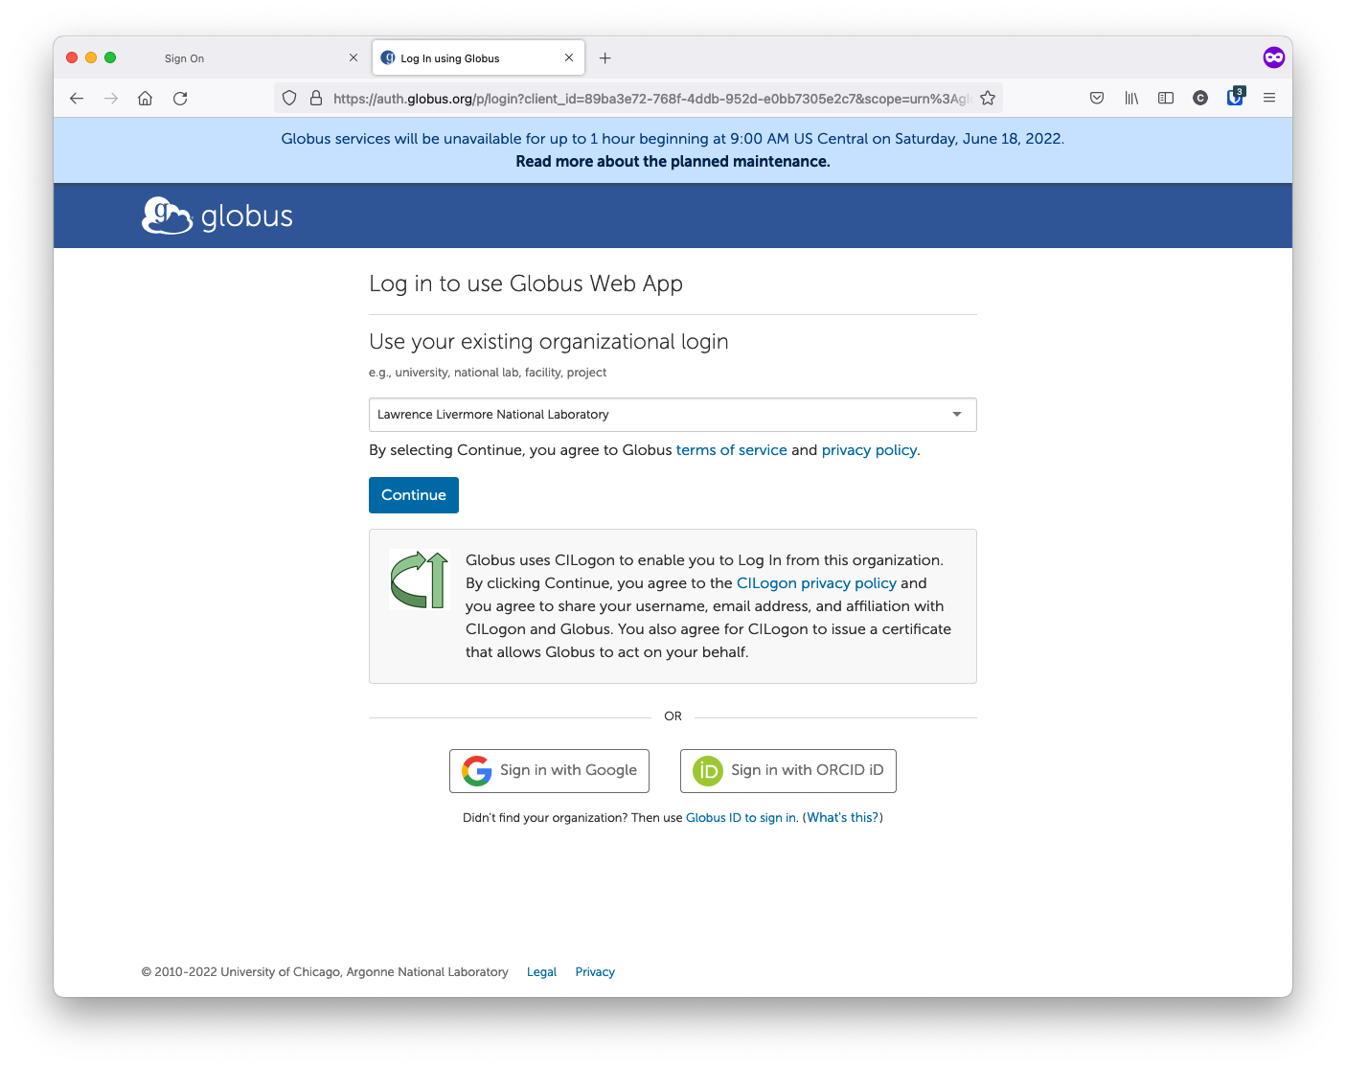
Logging in to Globus Web App (1)
Point your browser to https://app.globus.org
Select Lawrence Livermore National Lab (if prompted)

Slide 8
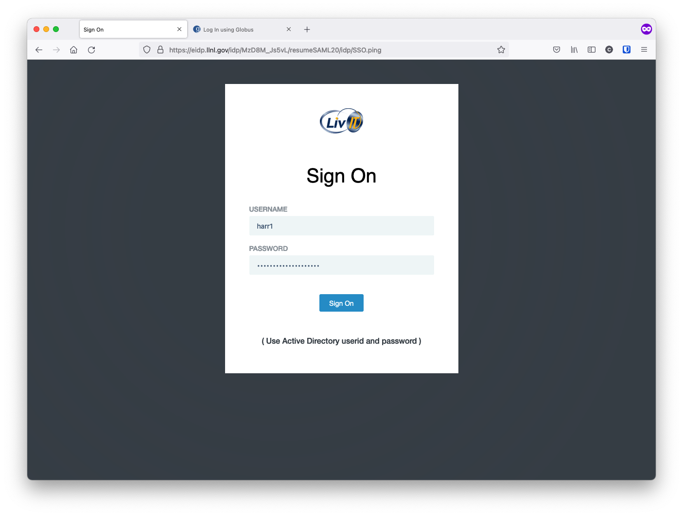
Logging in to Globus Web App (2)
If prompted, log in to LivIT Identity Provider (IdP) with AD creds
Select Lawrence Livermore National Lab (if prompted)

Slide 9
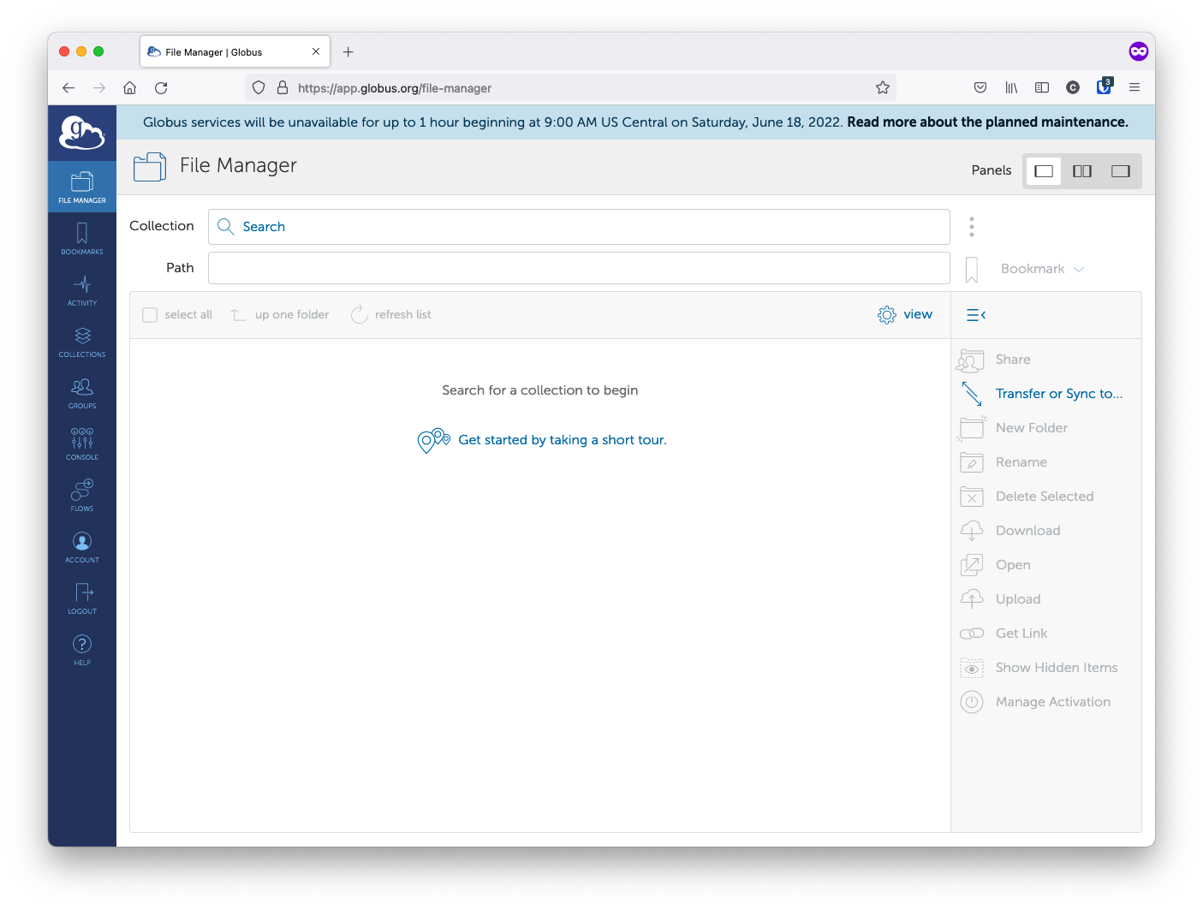
Globus File Manager (1)
Globus File Manager is default view
Browse for Source and Destination Endpoints

Slide 10
Globus File Manager (2)
LC Endpoint is LC Public
Users should be placed in their data share: /p/globfs/<user>

Slide 11
Globus File Manager (3)
Select operation on right panel:
Transfer: transfer files between two endpoints
Share: Make a group of your files available to non-LC users

Slide 12
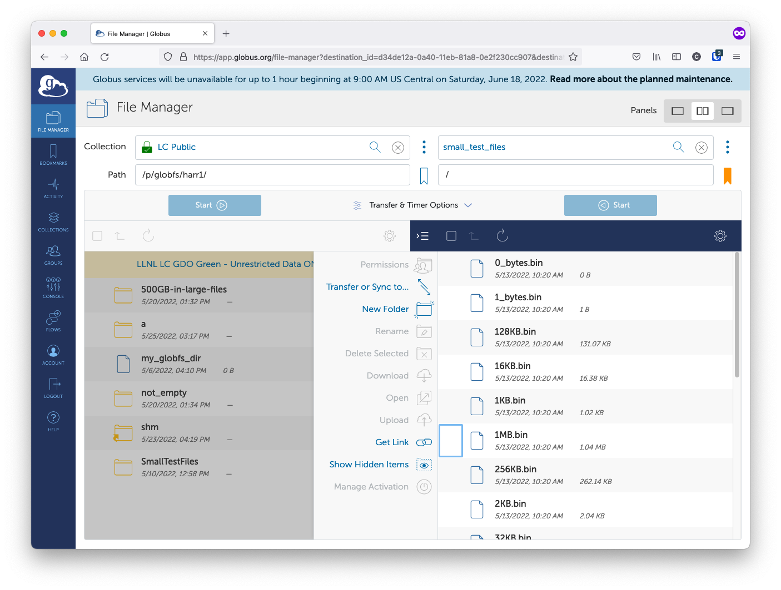
Transferring Files (1)
Browse to two endpoints after clicking “Transfer or Sync to…”
Choose ”small_test_files” collection

Slide 13
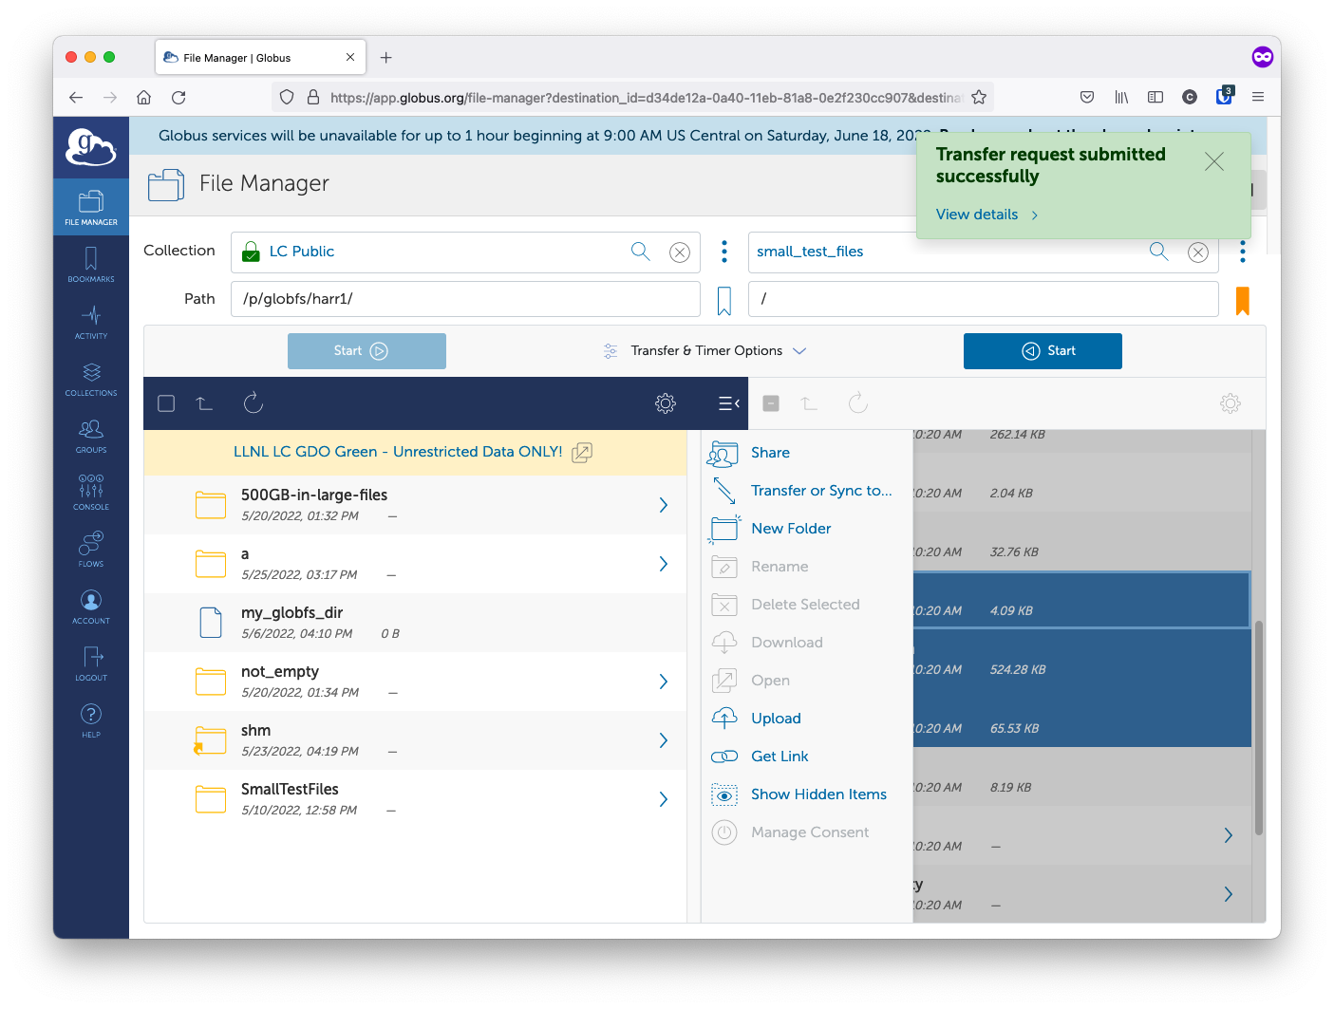
Transferring Files (2)
Select 1 or more files (Shift-click for multiple)
Click “Start” or just drag and drop to your directory

Slide 14
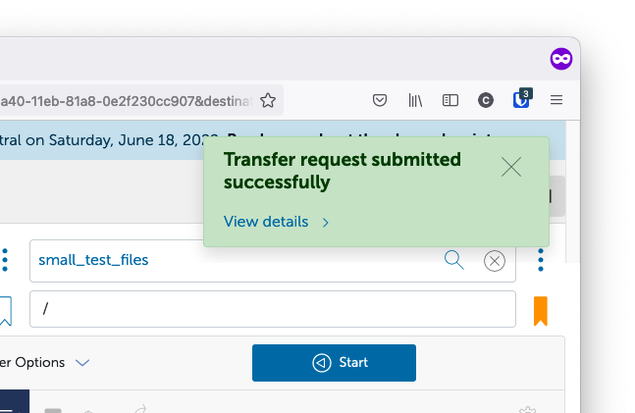
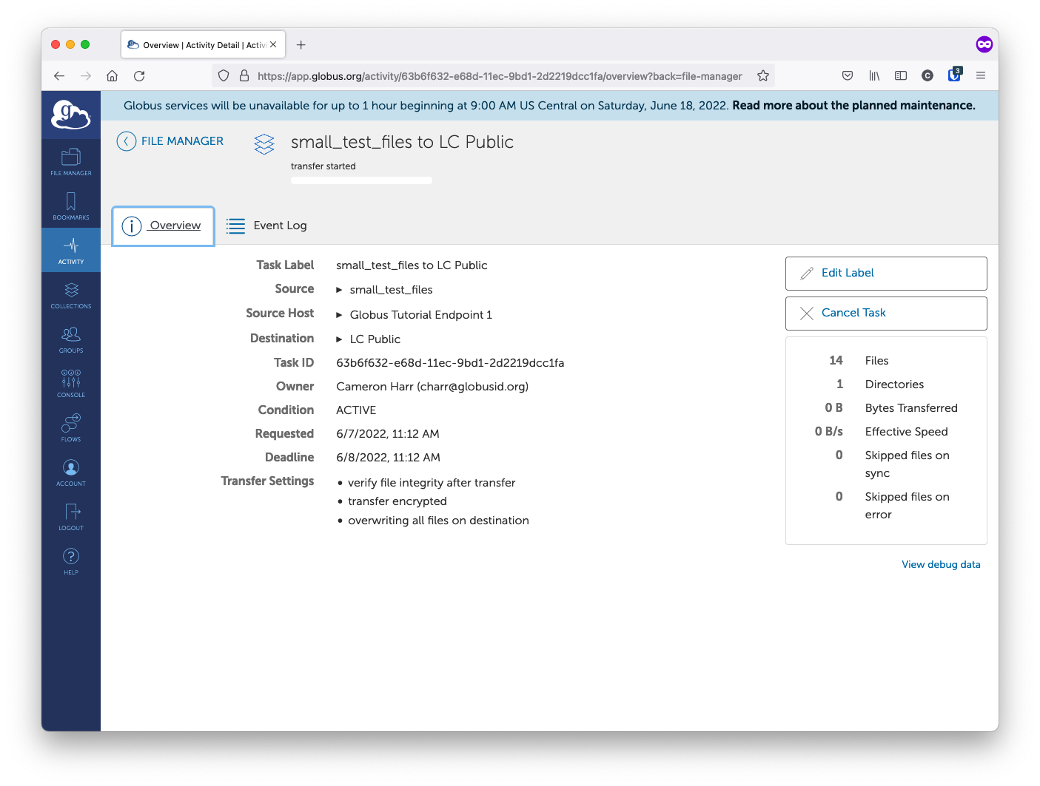
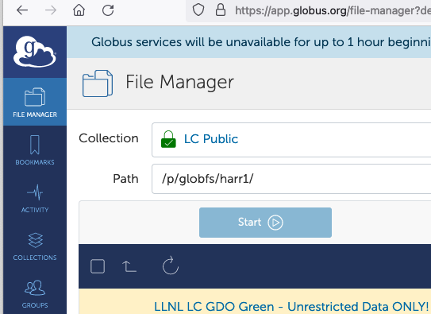
Transferring Files (3)
Monitor transfer by clicking on “View Details” or “Activity”

Slide 15
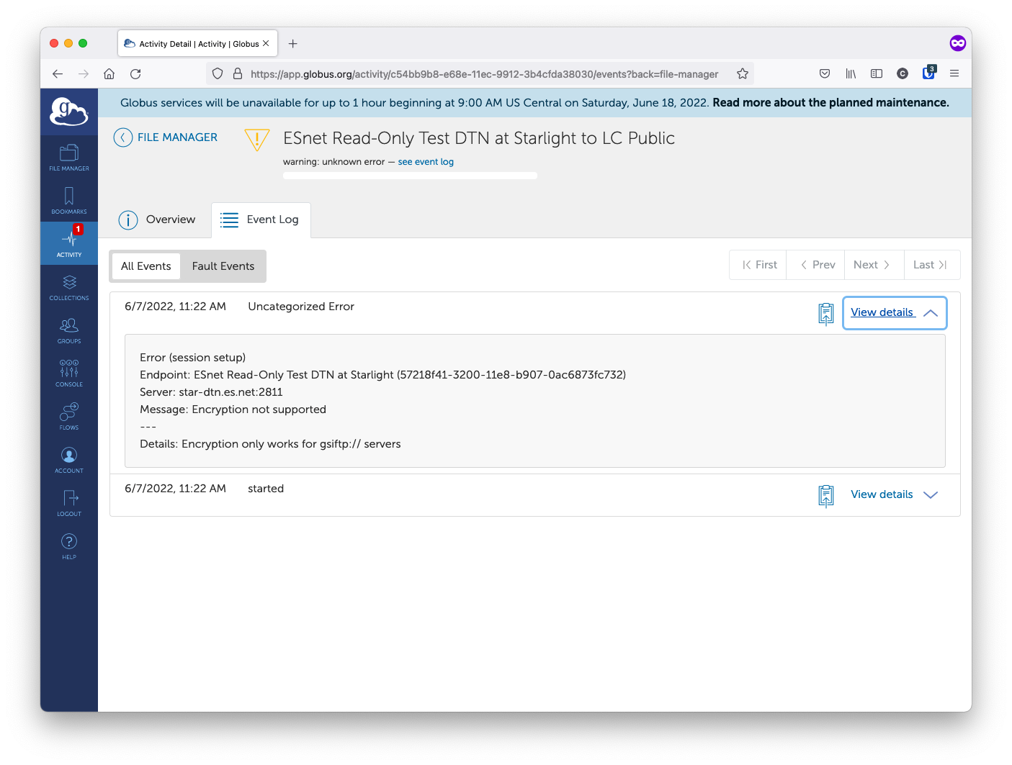
Transferring Files – Failure (1)
Check Event Log for failure messages

Slide 16
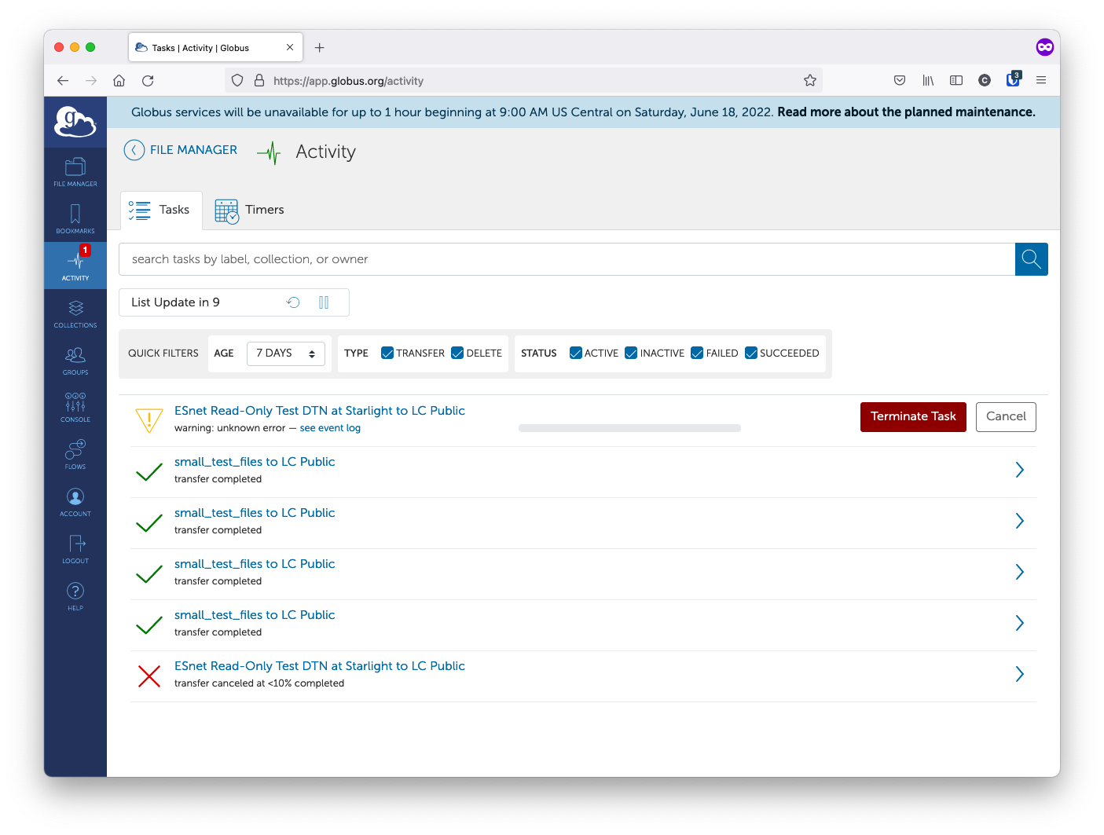
Transferring Files – Failure (2)
Globus will keep retrying transfer
If transfer will never succeed, “Terminate” the task via ”Activity tab

Slide 17
Transferring Files - Troubleshooting
Errors generally caused by sharing/permissions problems or server problems.
Users should get email on all transfers signifying Success or Failure.
1st step at debugging failure is to look at Event Log
Verify they are using an endpoint that supports encryption
Note other error messages
If stumped, or it looks like a server problem, contact LC Hotline

Slide 18
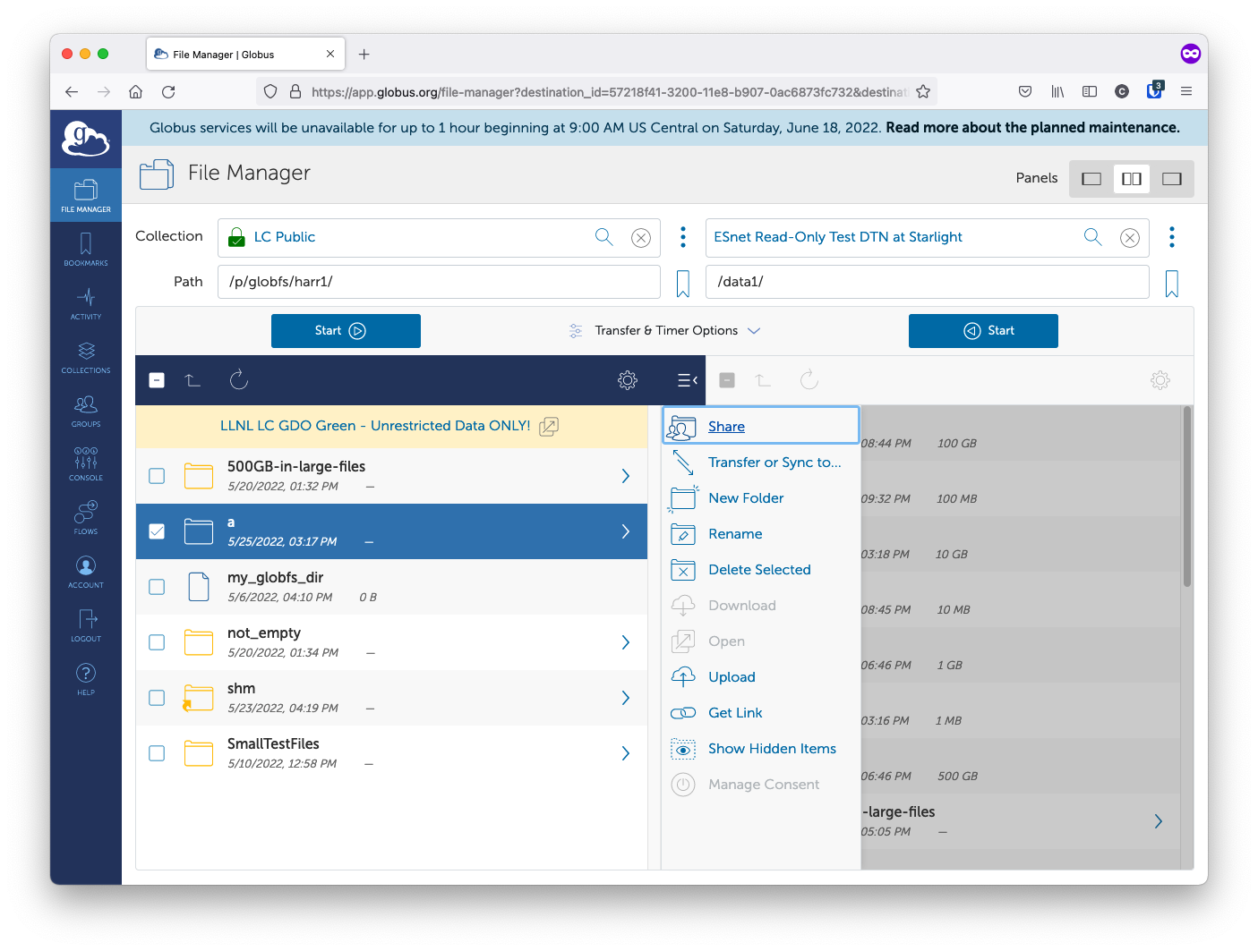
Sharing Files (1)
Select files to share and click “Share”
https://docs.globus.org/how-to/share-files/

Slide 19
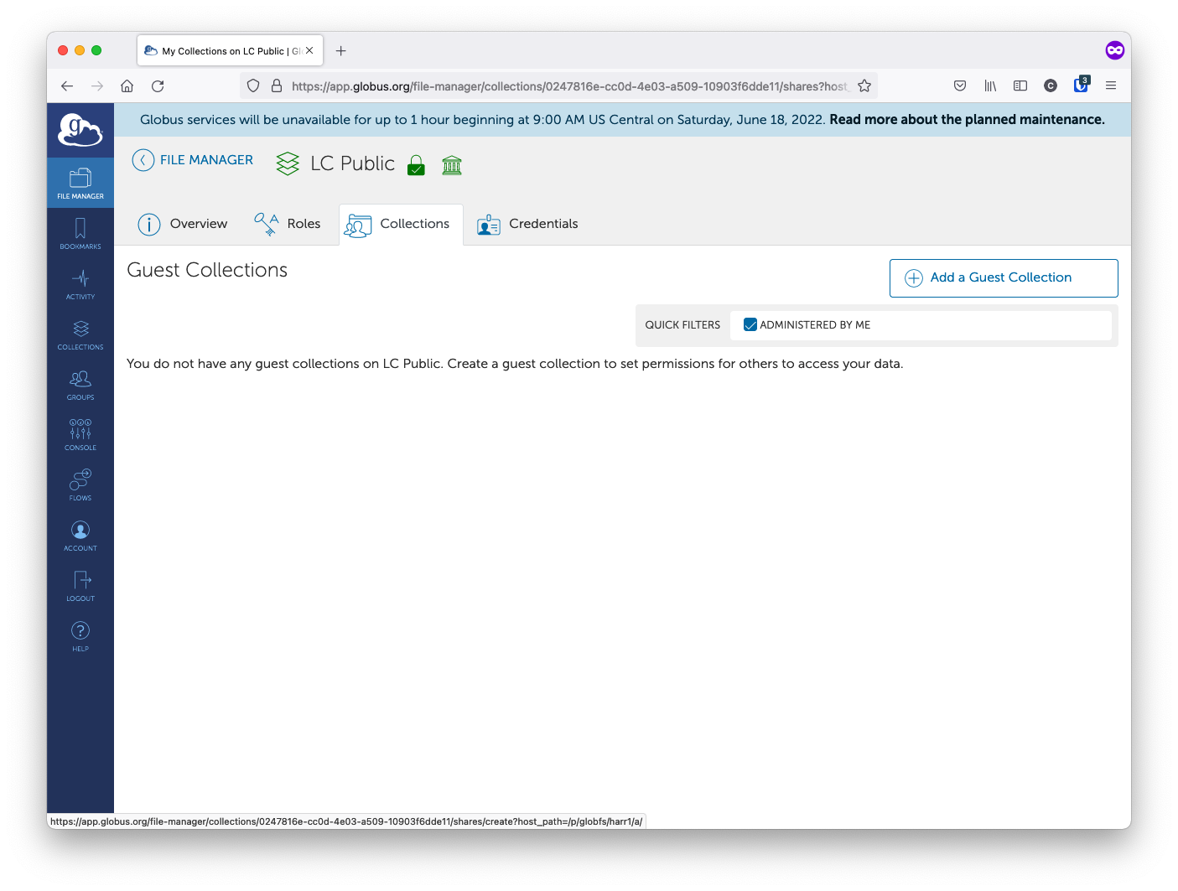
Sharing Files (2)
Create a Guest Collection or add to existing one

Slide 20
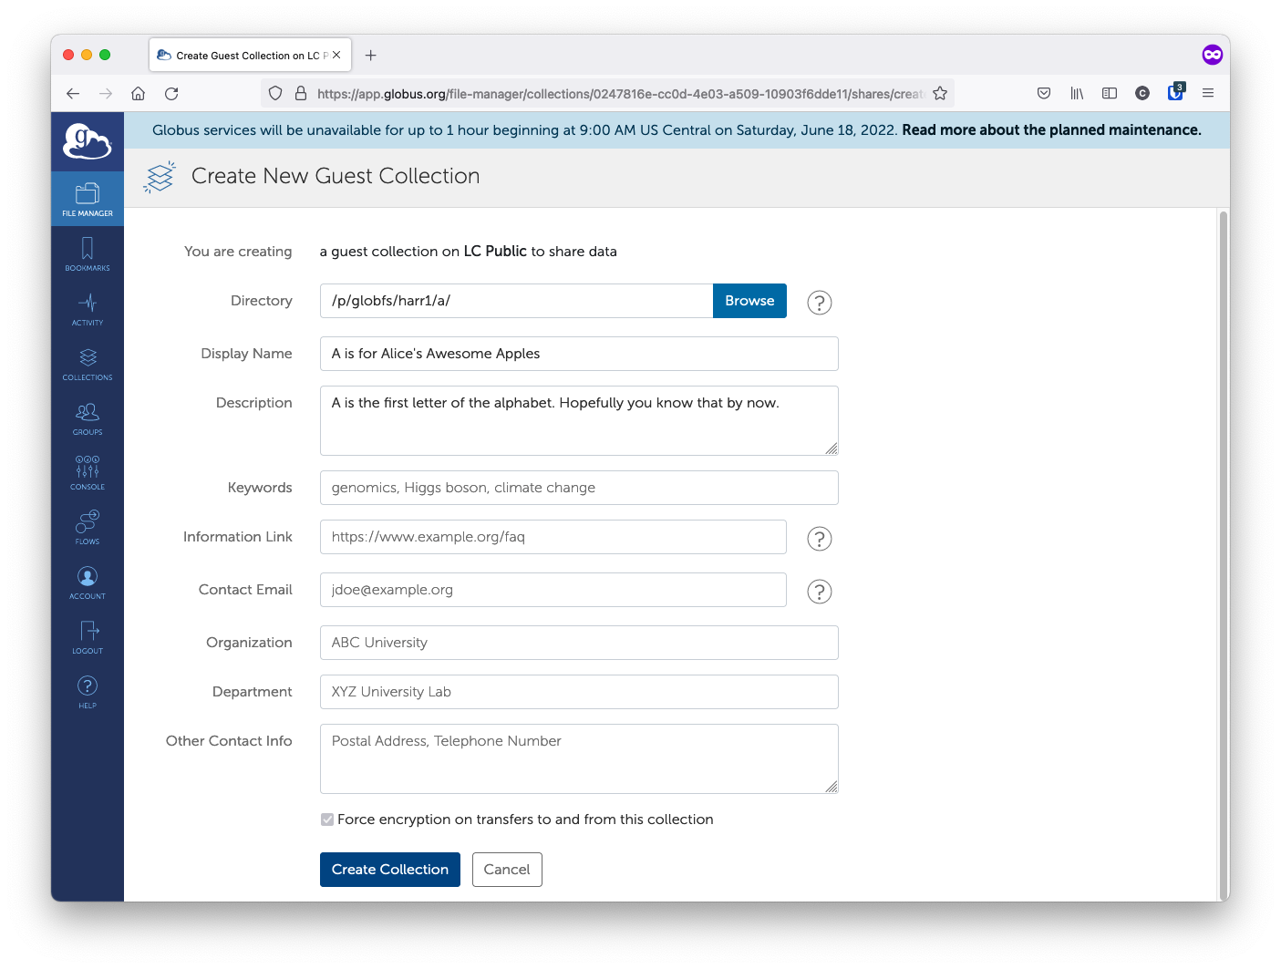
Sharing Files (3)
Fill out relevant fields and click “Create Collection”

Slide 21
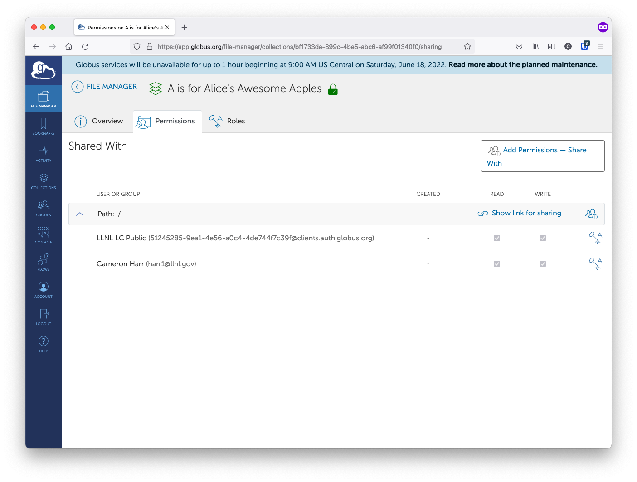
Sharing Files (4)
Add users and set permissions

Slide 22
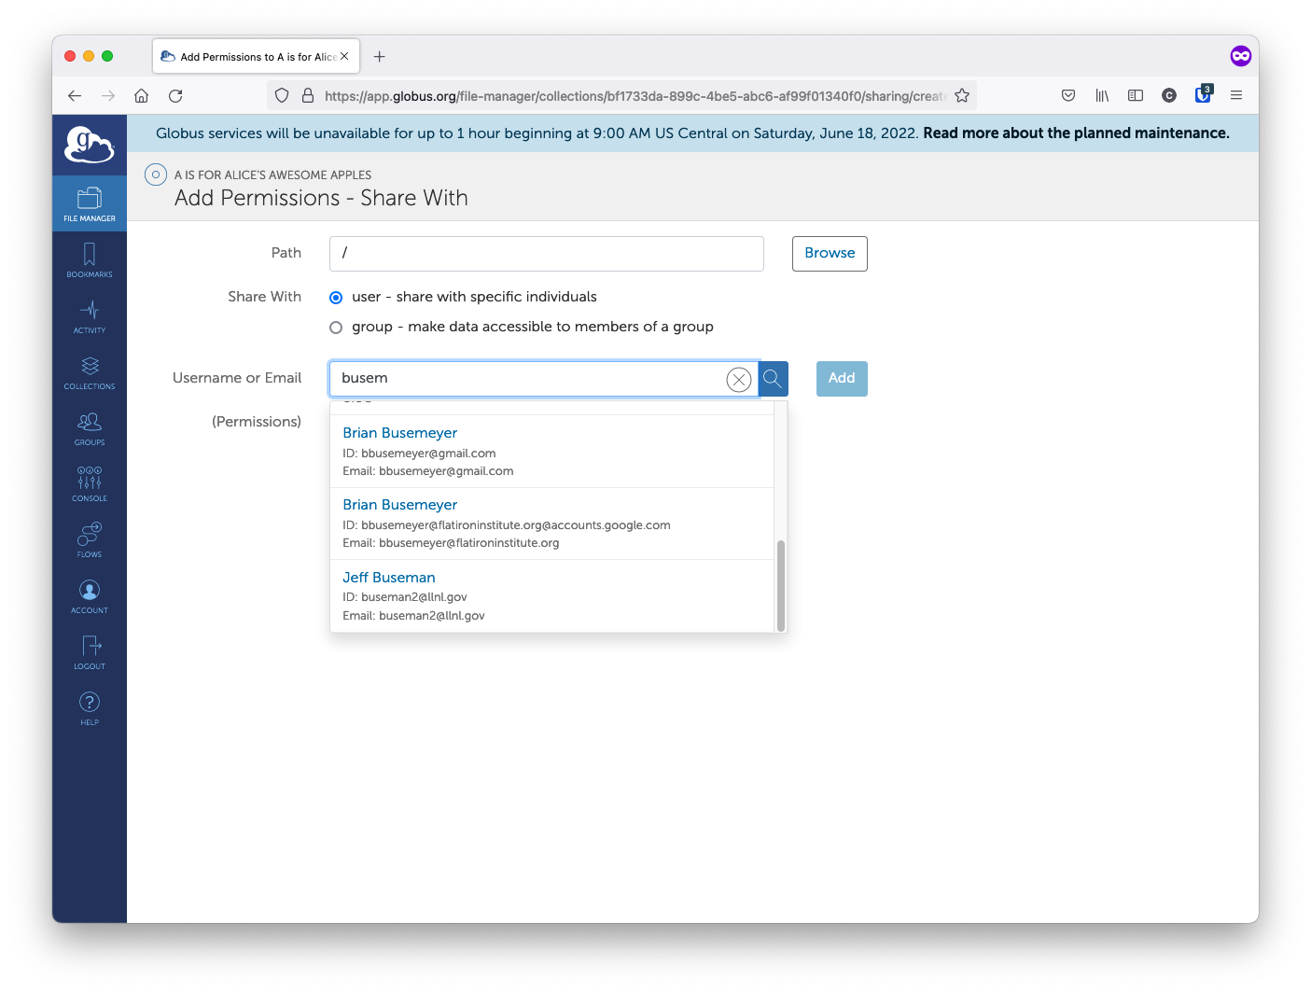
Sharing Files (5)
Path is relative to the collection you’re sharing
So “/” == “/p/globfs/harr1/a”
Username/email auto-matches valid users as you type
Select Read/Write permissions (default is read-only)

Slide 23
Sharing Files (6)
Verify user(s) show as having access to collection
Can also provide link to those who already have access

Slide 24
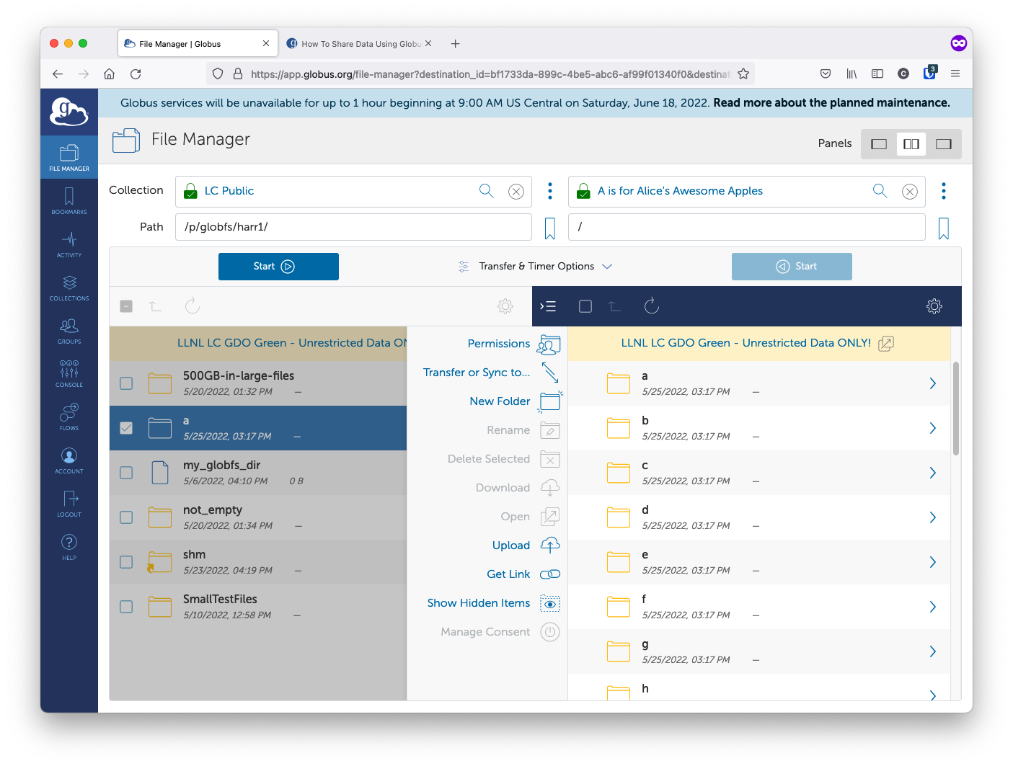
Sharing Files (7)
Those with access should be able to browse to collection

Slide 25
Q&A

Slide 26
Disclaimer
This document was prepared as an account of work sponsored by an agency of the United States government. Neither the United States government nor Lawrence Livermore National Security, LLC, nor any of their employees makes any warranty, expressed or implied, or assumes any legal liability or responsibility for the accuracy, completeness, or usefulness of any information, apparatus, product, or process disclosed, or represents that its use would not infringe privately owned rights. Reference herein to any specific commercial product, process, or service by trade name, trademark, manufacturer, or otherwise does not necessarily constitute or imply its endorsement, recommendation, or favoring by the United States government or Lawrence Livermore National Security, LLC. The views and opinions of authors expressed herein do not necessarily state or reflect those of the United States government or Lawrence Livermore National Security, LLC, and shall not be used for advertising or product endorsement purposes.
This work was performed under the auspices of the U.S. Department of Energy by Lawrence Livermore National Laboratory under contract DE-AC52-07NA27344. Lawrence Livermore National Security, LLC

