Slide 1
Duo: AI for GitLab
LC User Meeting
March 13th, 2025
John Consolati

Slide 2
What is it?
New GitLab functionality that lets GitLab talk to an LLNL-managed large language model
AI inference capabilities are accessible across the GitLab web UI, GitLab web IDE, and various desktop IDE plugins
GitLab context-aware AI enables many features:
  Today: chat, code suggestions, code explanation, code refactoring, code fixes, test code generation
  Future: Summarize discussions in issues/MRs, generate MRs automatically, root cause analysis for CI pipeline failures, code vulnerability analysis

Slide 3
Where is it?
Deployed as Early Access to CZ GitLab late January 2025, announced via Tech Bulletin #576
LC purchased 100 seats for the pilot, and there are seats remaining for interested users. Contact lc-gitlab-admin@llnl.gov
Exploring possibilities for RZ deployment (soon) and SCF (later). Details in subsequent slides.

Slide 4
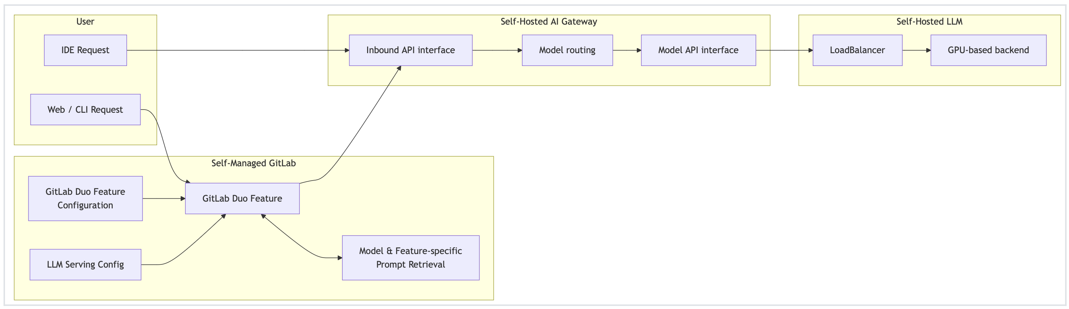
Component Architecture
Source: gitlab.com
Duo introduces several new components, but this quick primer will focus on the end-user experience (starred). Where can I use it, and what models are backing it?

Slide 5
User Desktop IDE Integration
GitLab provides plugins for various desktop IDEs such as VSCode, JetBrains, Visual Studio
Plugins authenticate to CZ GitLab using a Personal Access Token (PAT) over 443/HTTPS
  Same PAT as today; subject to 30-day expiration

Slide 6
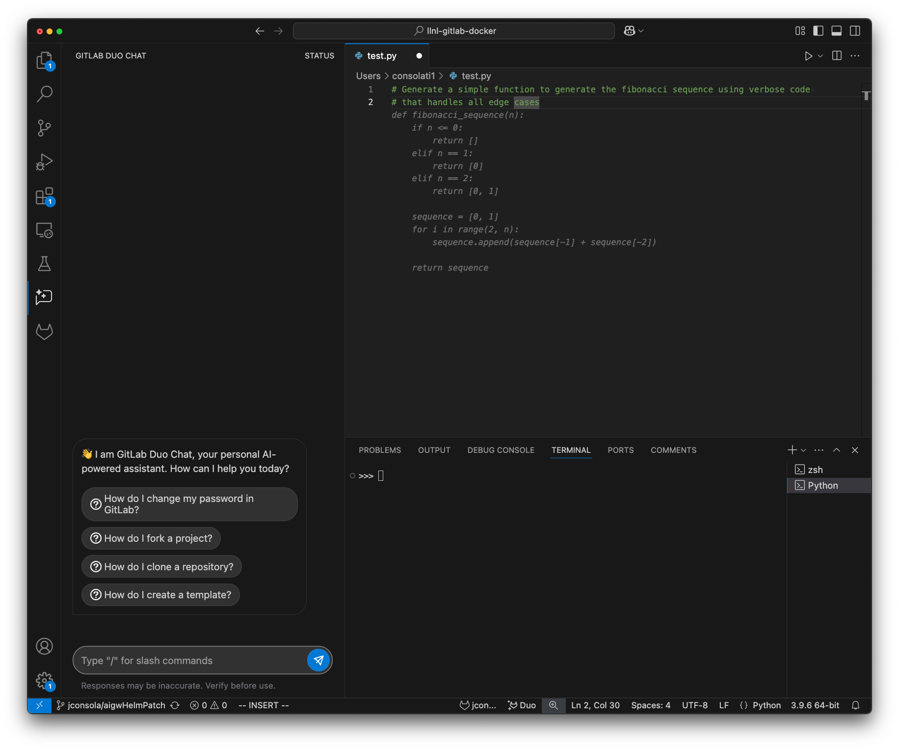
Desktop IDE – Example Workflow

Slide 7

Desktop IDE – Example Workflow

Slide 8
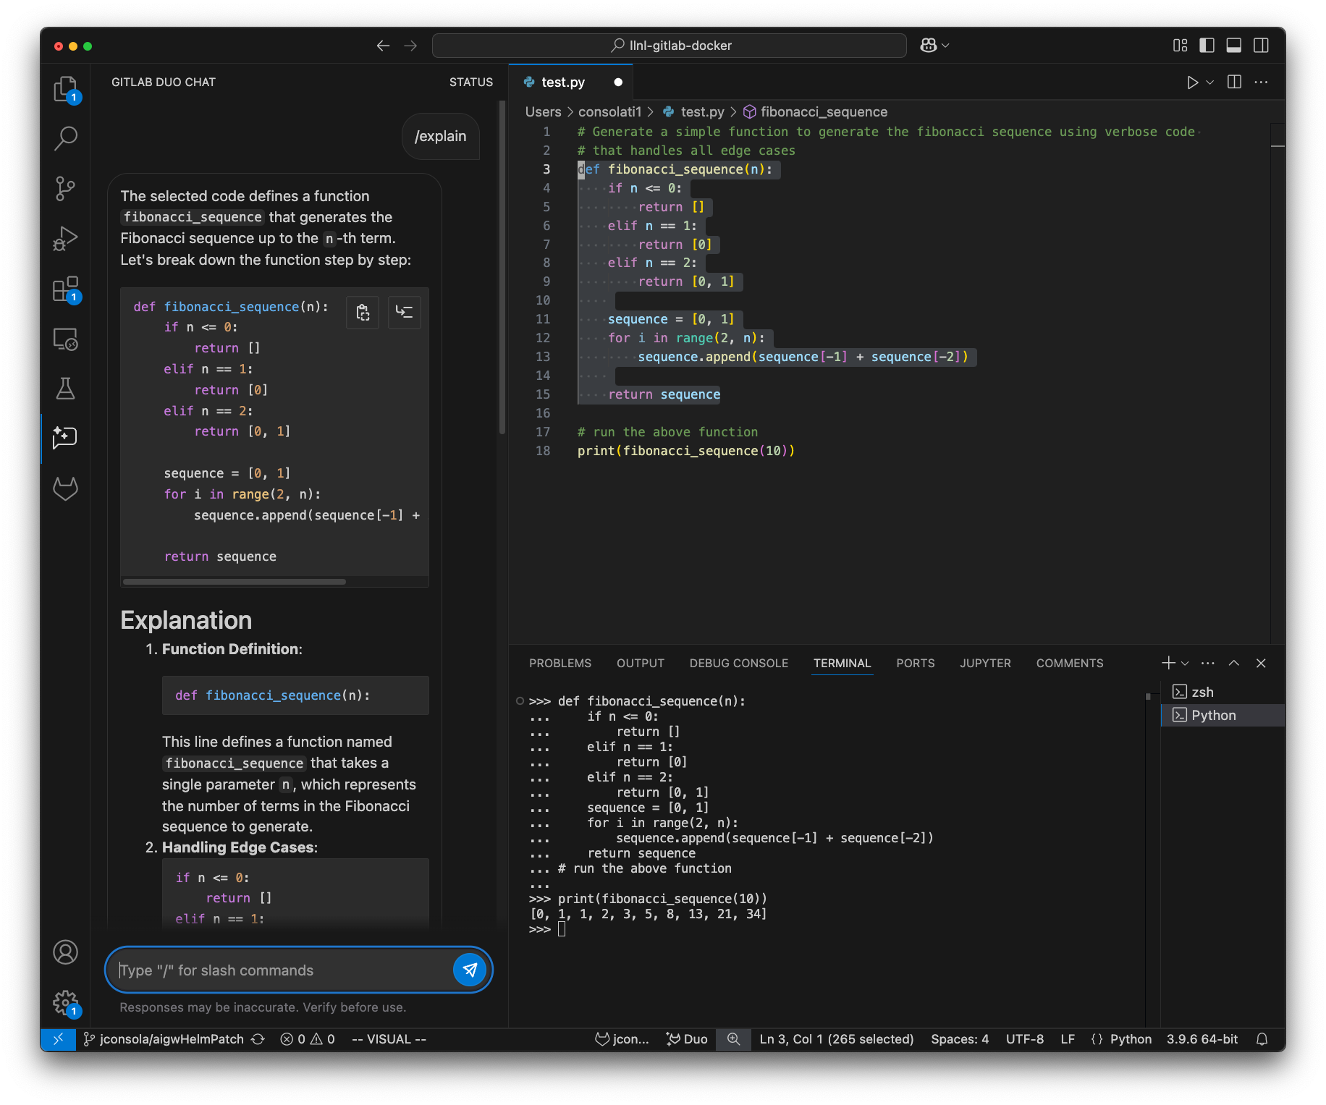
Desktop IDE – Example Workflow

Slide 9
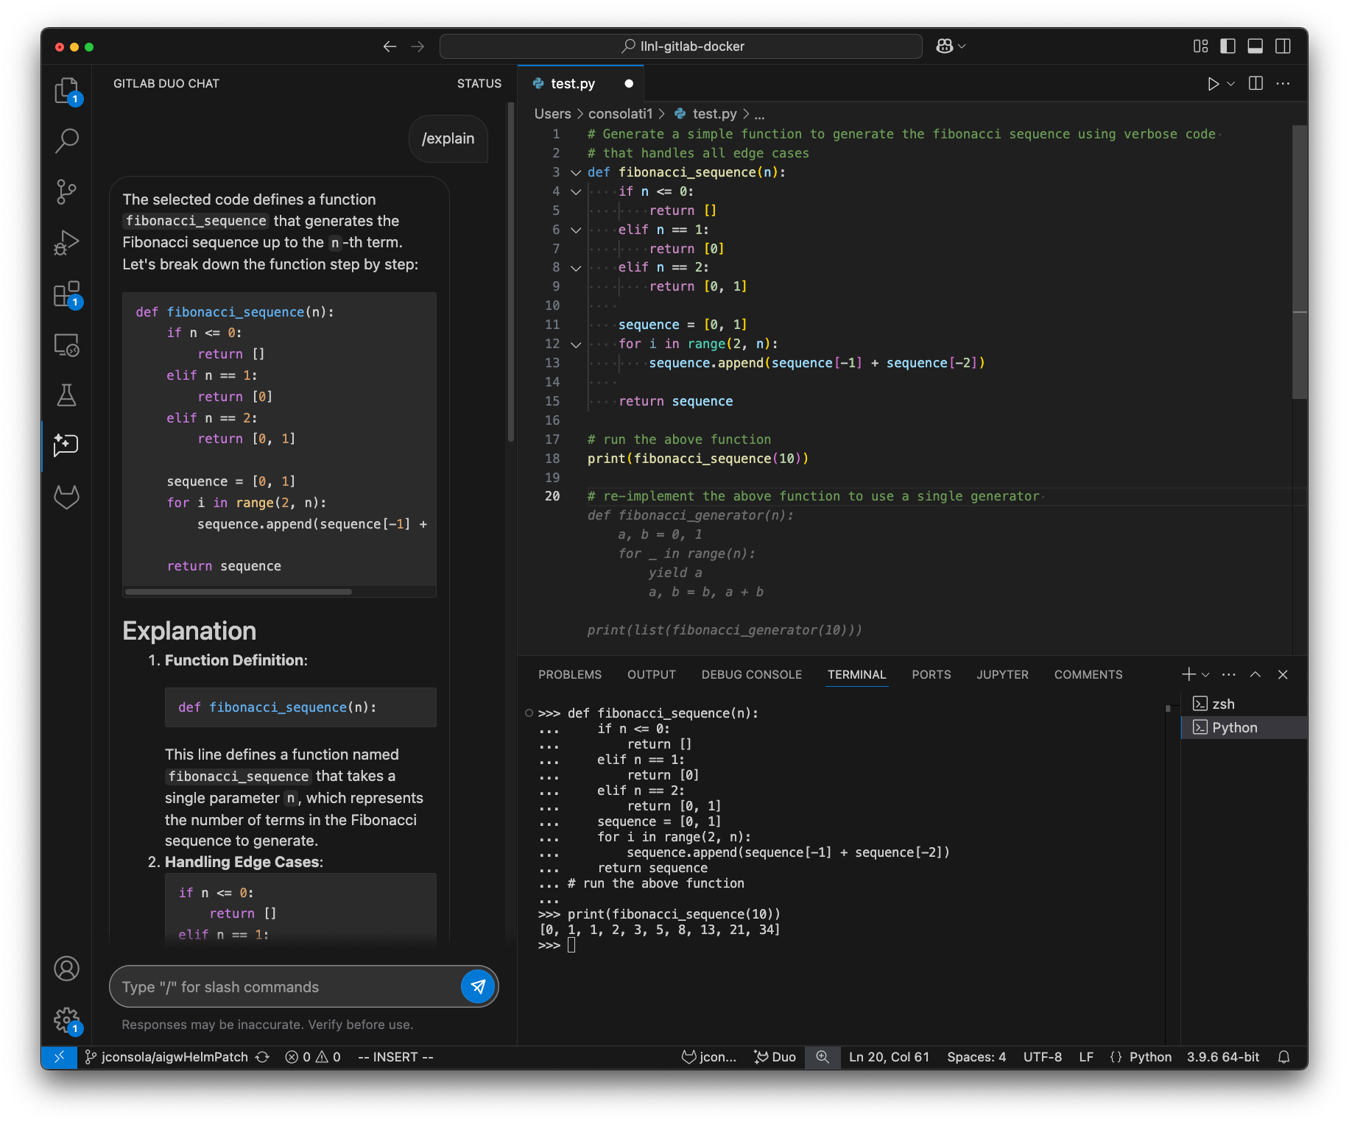
Desktop IDE – Example Workflow

Slide 10
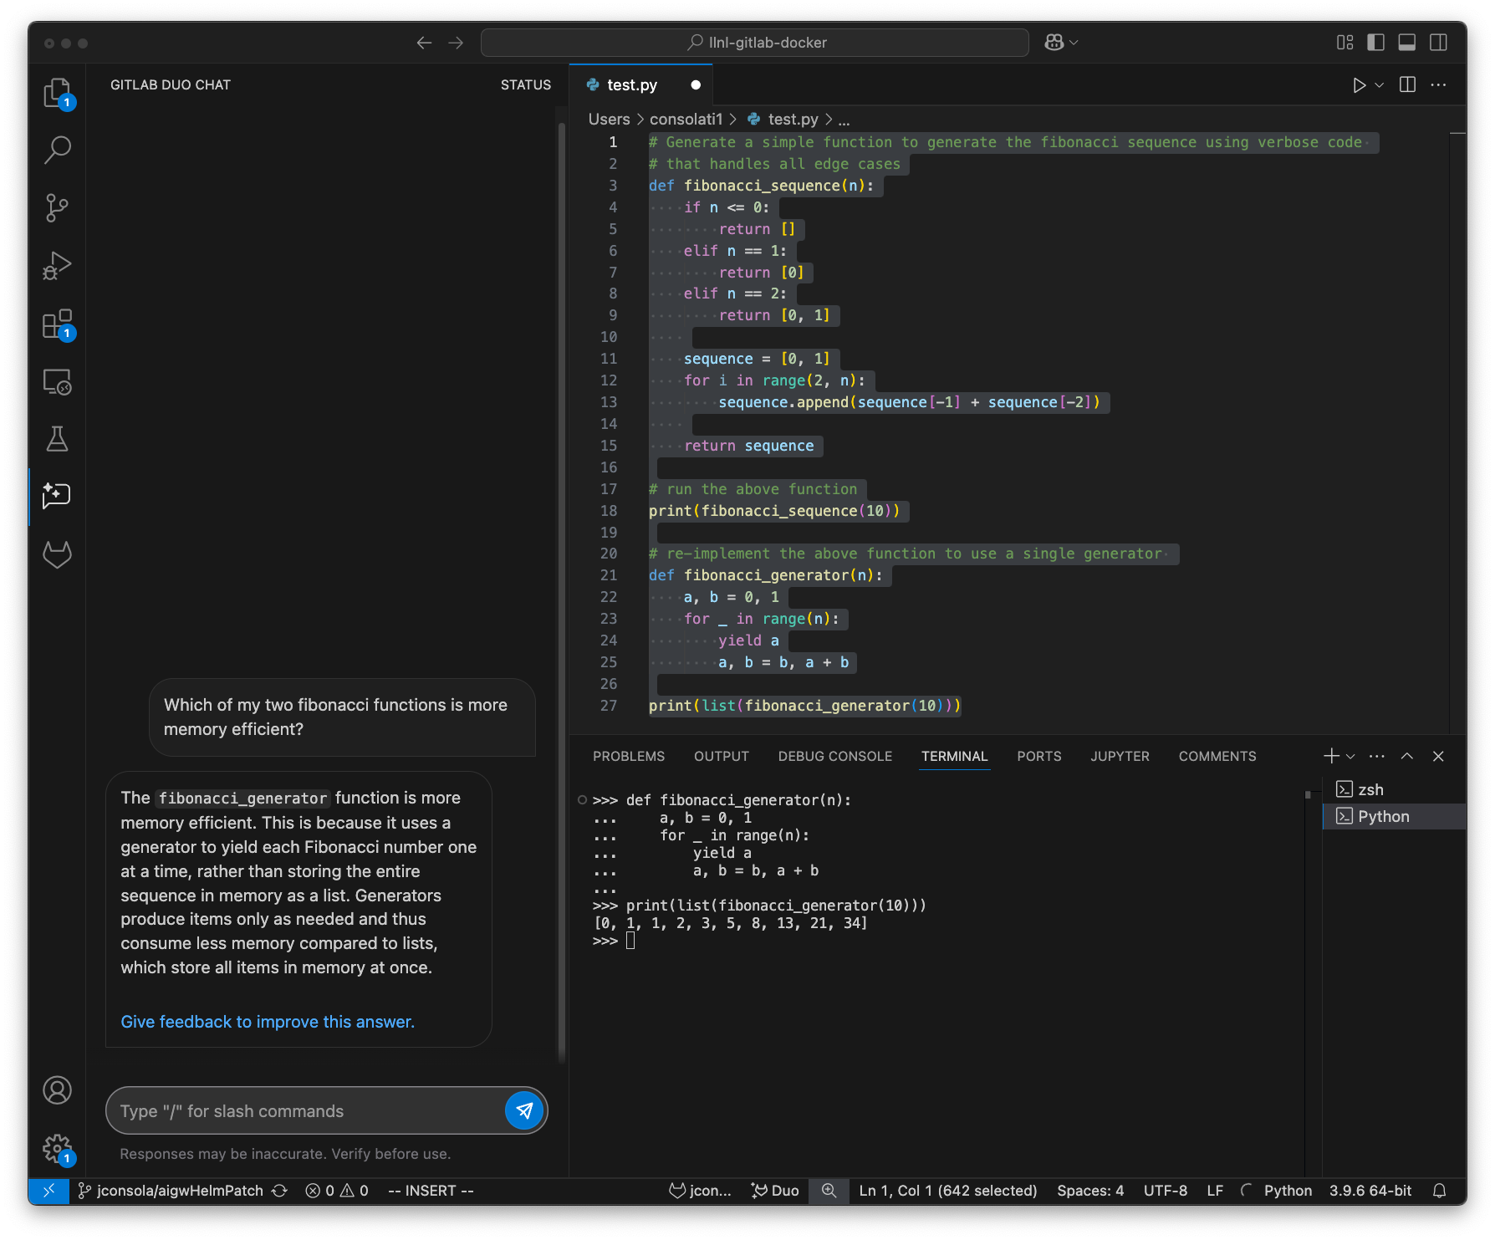
Desktop IDE – Example Workflow

Slide 11
Web UI / IDE Integration
Duo chat also available on the GitLab web UI with the same capabilities
  Chat sessions will carry over between the web and your IDE
The web IDE within GitLab (VSCode) also supports Duo in a similar fashion

Slide 12
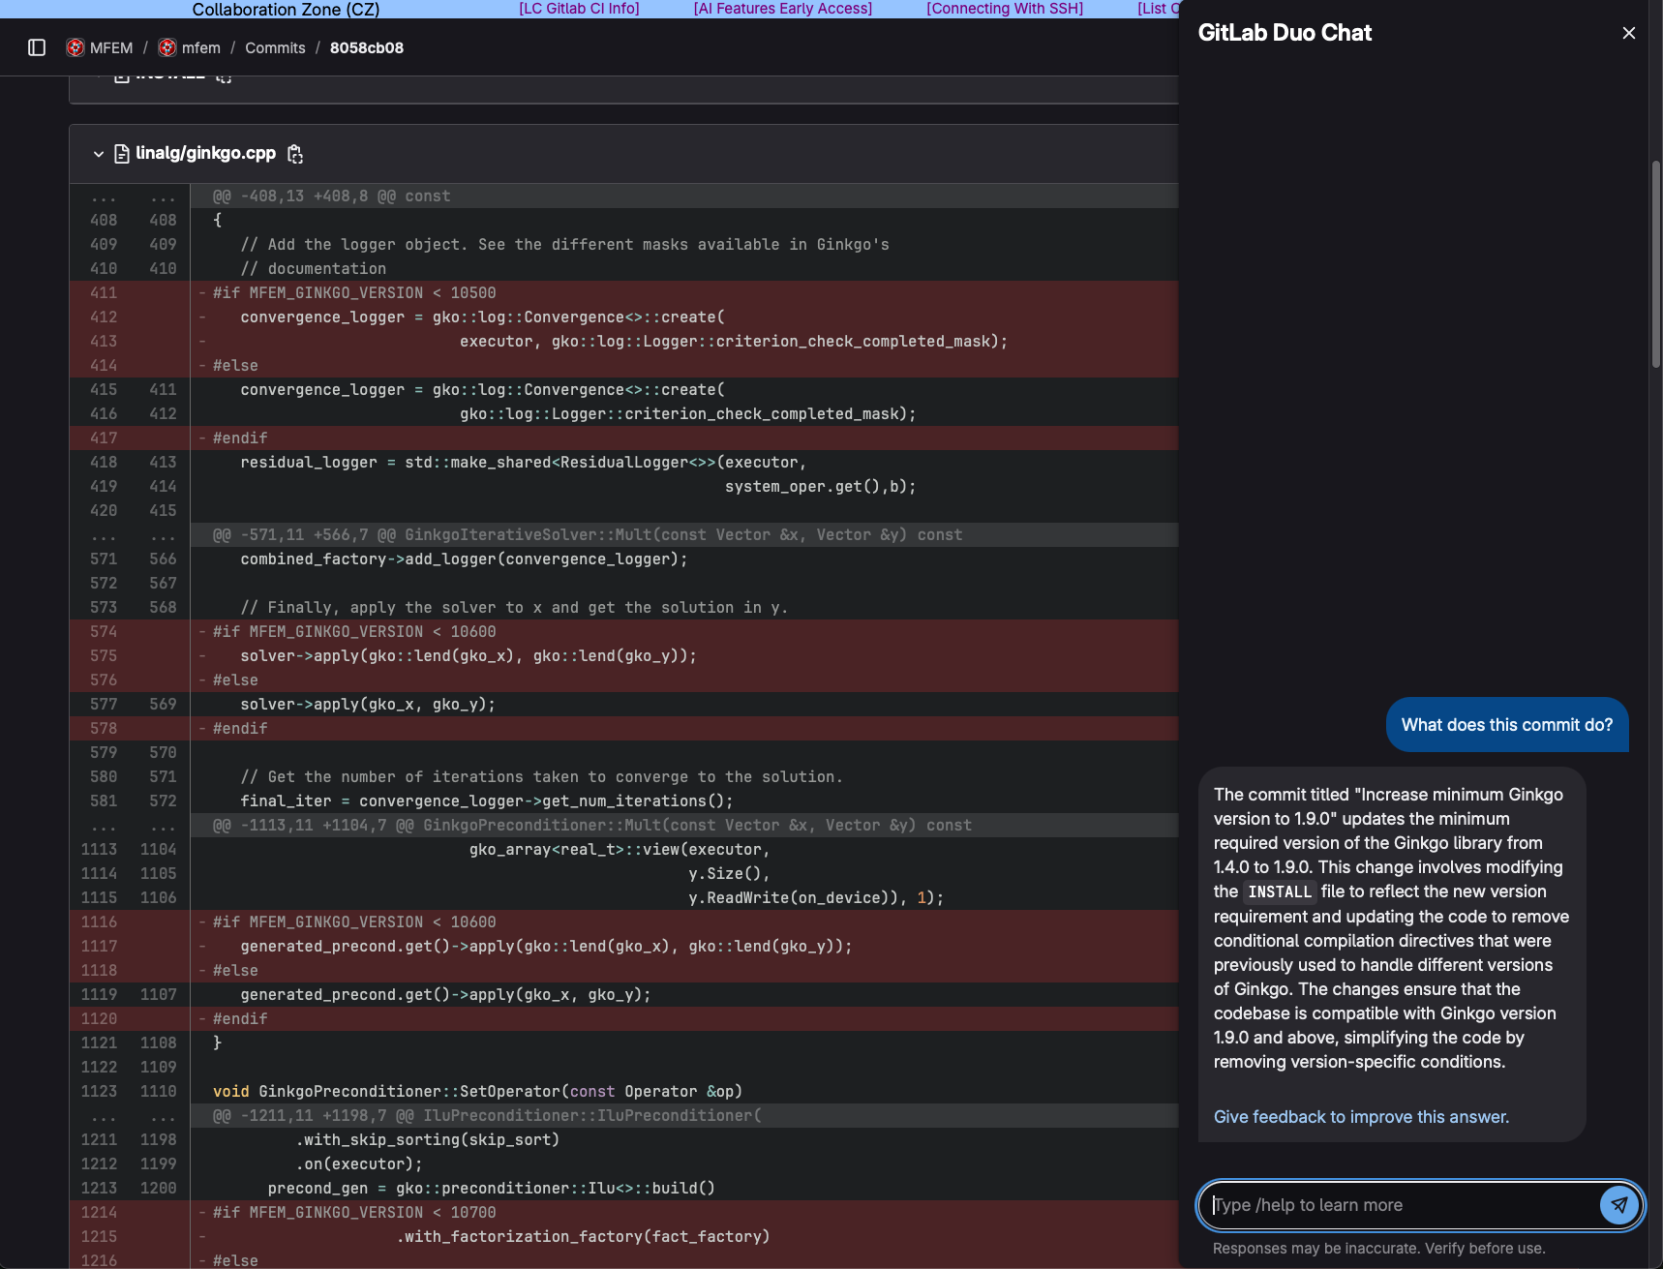
Web UI - Example

Slide 13



Supported Models & Hosting Environments
Hosting Platform | GitLab Supported Models | Notes
Fully on-prem ($$$) | Mistral series Mixtral series CodeGemma (future) CodeLlama (future) DeepSeek Coder (future) | On-prem involves procuring new hardware or reconfiguring HPC nodes DeepSeek not LLNL approved
Amazon Bedrock ($) (GovCloud instance) | Mixtral series Claude 3.5 Sonnet | Usable in CZ only
Azure OpenAI ($) (Government instance) | GPT series Llama 3 series | Usable in CZ only Pilot currently using GPT-4o
Icons represent degree of accuracy in model responses for GitLab use cases
Combinatorial problem of model support, model accuracy, cost, security, and hardware availability

Slide 14
What’s next?
Launching pilot for RZ GitLab. Will initially run models hosted on rzvernal.
Evaluate viability of the Mixtral 8x22B-it model
  CZ pilot previously ran Mistral 7B-it which was insufficient
  Expecting results better than Mistral 7B but worse than GPT. Good enough?
Ensure stable infrastructure prior to general availability launch
Feature parity of Duo across different instances

Slide 15
Seeking Feedback
Accuracy & speed of responses
Ease of providing context to the model
Does it enable you to do things you couldn’t previously? What are the time savings?
How can we make this better?
If you use both CZ & RZ, do you notice differences between GPT and Mixtral responses?
lc-gitlab-admin@llnl.gov

