Slide 1
LC NAS Services
March 2025
Dave Fox, LC Systems Administration Group

Slide 2


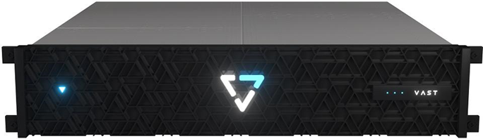

New and Update Storage Services
SCF and RZ Vast system
Vast DB
LC’s S3 service
Refresh of /usr/workspace servers

Slide 3
Vast Systems
CZ / RZ Vast
  One set of servers
    16 Cnodes - client connections – 100Gb Ethernet
    14 Dnodes – data storage – 44 16TB SSD per HA node pair
  NEW - RZ /p/vast1 just deployed last week ~ 1 PB
SCF Vast ~ 2 PB
  24 Cnodes – client connections – 100Gb Ethernet
  24 Dnodes – data storage – 11 16TB SSD per HA node pair
Default quota the same for all systems, 20TB and 1M files.

Slide 4



Vast DB
Vast – more than just a storage server, they are delivering numerous data services.
The VastDB interface is a SQL like interface to tables of data uploaded to the system. Not the normal POSIX files.
Queries can be made with Python or Trino (open-source parallel query engine) - Center for Predictive Bioresilience
Also testing S3 on Vast
Let us know if you have any possible use cases

Slide 5


LC’s S3 Service
Amazon S3 compatible storage service deployed with the Persistent Data Services environment (see Learn more at: hpc.llnl.gov/cloud).
Available in CZ, RZ, SCF.
Open side is now enabled to allow S3 access from outside of LC, enables movement of data in/out of LC (ie image capture from an experiment into LC for analysis/ML), fully automated.
In the future, plan to have S3 available from Vast and HPSS.
LLNL Enterprise Network
LC
Network
S3 object (get, put, delete) via https – keys managed via LaunchIT

Slide 6
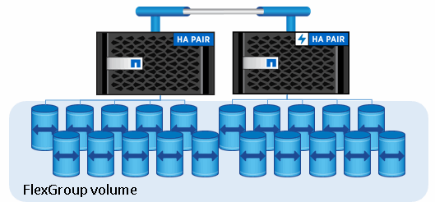
Refresh of Workspace servers
Started CZ/RZ refresh last year 1 of 4 server pairs replaced.
Waiting on budget approvals to do additional procurements
New servers are all flash based

