Slide 1
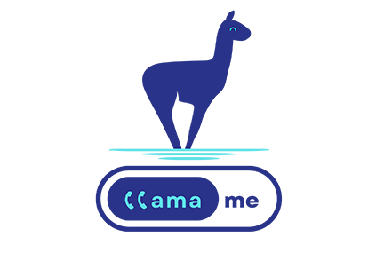
LLamaMe (LLM) API
LC user meeting
March 13th, 2025
Otto Venezuela | HPC Cloud Enabler Officer
otto@llnl.gov
representing many doers in LC
WORKFLOW ENABLEMENT GROUP

Slide 2
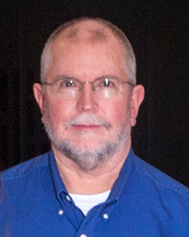
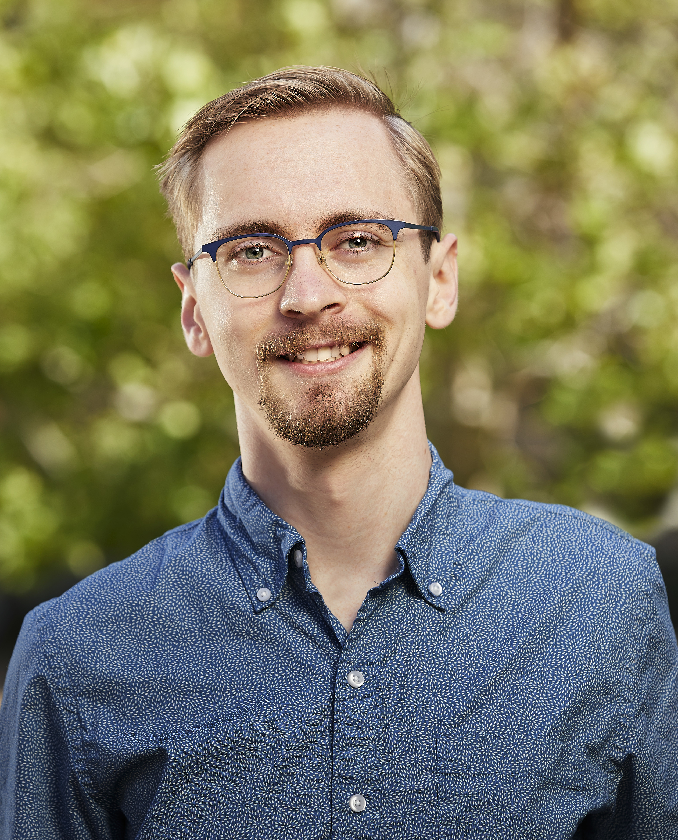
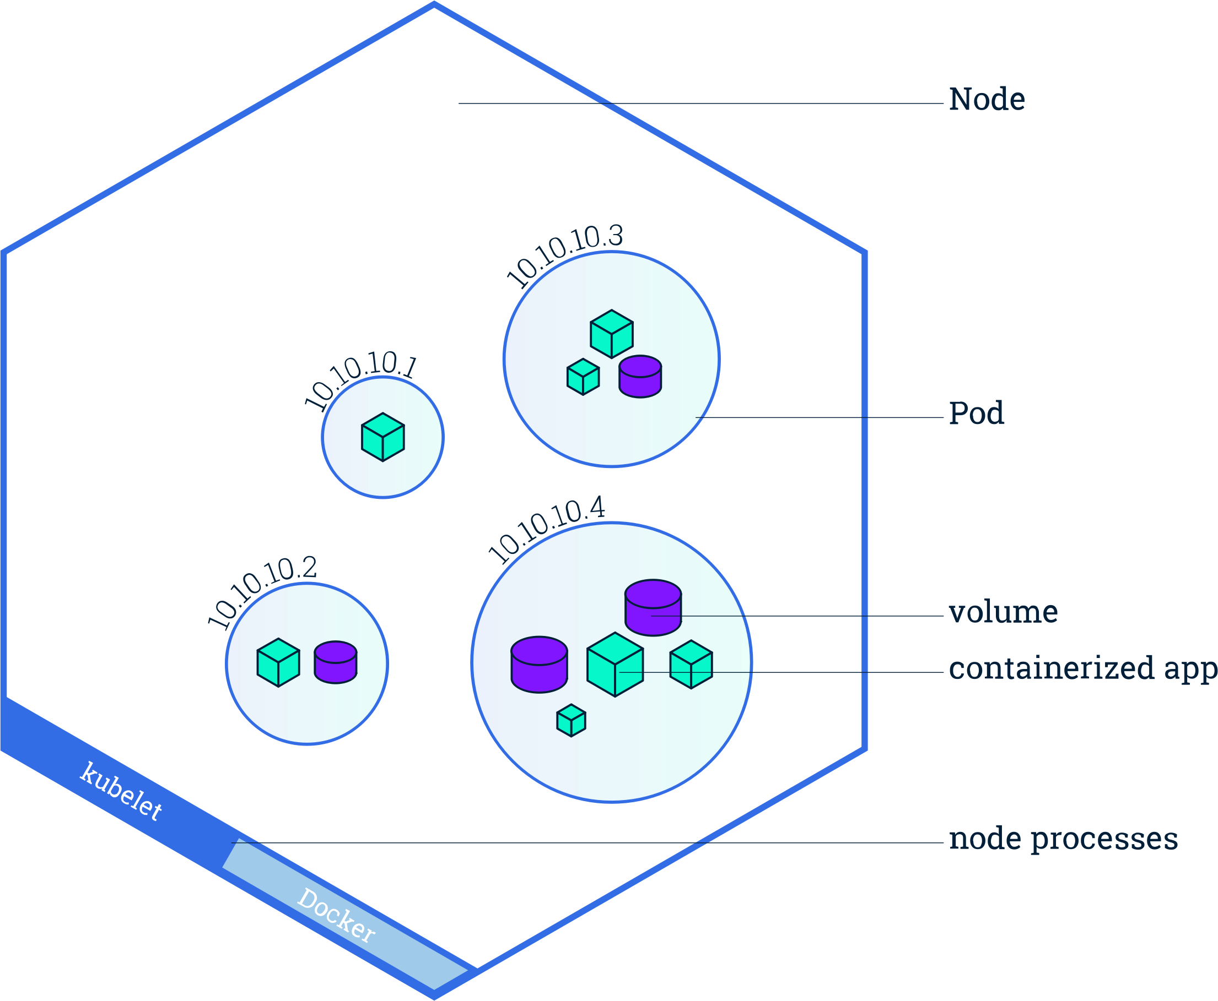
The nexus of cloud technologies, new workflows and traditional LC HPC ecosystems
WORKFLOW ENABLEMENT GROUP
Paul Bryant
(ORNL)
A deep bench of diverse talent to aid HPC with challenges of disruptive technology
Conner Cook
John Consolati
(Team Lead)
James Corbett
John Westlund
Todd Heer
(Group Lead)
Urwah Mir
Workflow Enablement Group
Thomas Mendoza
(contractor)
Crucial Cross-Group Collaborators/Contractors
Zeke Morton
Neil O’Neill
Jordan Dorham
James Taliaferro
Otto Venezuela
(Team Lead)
David Fox
(Project Lead)
Notes:
Slide Deck Last Updated: 8/2/2023
Teams:
WST – web services team
MPR – Macro Pipeline Refinement

Slide 3
Delivering on HPC Convergence Realizing the promise of production DevOps engineering leveraging On-premises cloud-native technologies
Persistent Data Services (PDS) - curated containerized secure user-provisioned data applications
Bespoke software stack deployments - enabling HPC right next to the “big iron”
Object Storage - s3-protocol object data stores
AI - workflows integrated with hosted LLMs; AI accelerator h/w integration
Container orchestration - Kubernetes / OpenShift
Repos and image security scanning - Nexus, Trivy, Gitlab registries
Continuous Integration (CI) - Custom runners for local & multi-institutional cross-site CI
Workflow tools - Merlin (LLNL), Sina (LLNL), Fireworks, CDash, AiiDA
Flux - scheduler development fused with storage container and cloud integration
LC Web Services - Atlassian suite, Gitlab
Container telemetry - Advanced Cluster Monitoring, Elasticsearch, Kibana, Grafana, Prometheus
Automatable LC workflows from inside & outside “the LC bubble” - trigger tokens, object store keys
Workflow Enablement Group
Jacamar
Learn more at: hpc.llnl.gov/cloud
Learn more at: hpc.llnl.gov/cloud
Notes:
WEG Technology Stew
<read title>

Slide 4
LLamaMe (LLM) API Service
LLamaMe API represents a significant advancement in providing users with seamless access to locally-hosted open-source Large Language Model (LLM) via the REST API endpoint
Providing this new LLamaMe API access allows users to integrate HPC jobs, integrated development environment (IDE), Retrieval-Augmented Generation (RAG) systems and LLM Agents.
Currently deployed using Nvidia GPU nodes in CZ, RZ, and SCF OpenShift cluster
Network | Model | Max Tokens | GPUs
CZ | Meta-Llama-3.1-70B-Instruct-AWQ-INT4 | 4096 | 2 NVIDIA A100 80GB
RZ | Meta-Llama-3.1-8B-Instruct | 4096 | 1 NVIDIA A100 40GB
SCF | <TBD: Mixtral 8x7B> | <TBD> | 4 NVIDIA H100 80GB
Available in CZ and RZ as Limited Availability (LA) since Sept. 2024 ( SCF LA in April 2025)

Slide 5
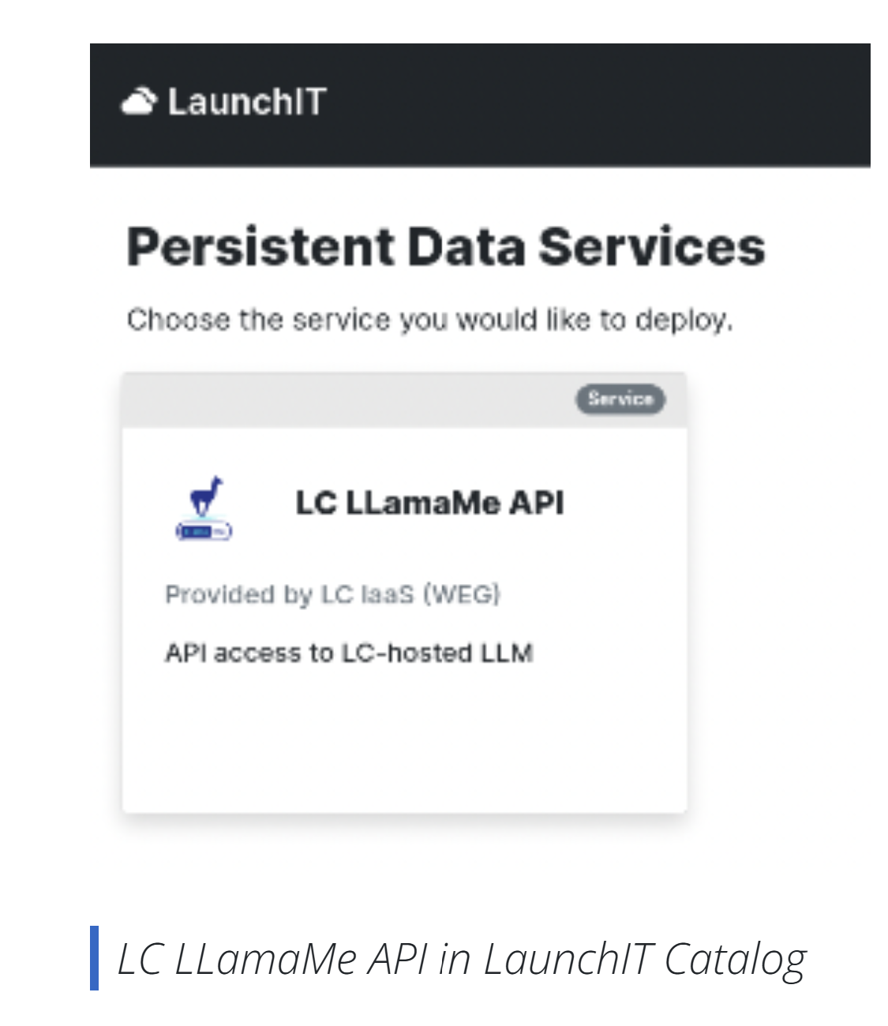
Adding LLamaMe into LaunchIT upcoming release
WORKFLOW ENABLEMENT GROUP
Upcoming LaunchIT ver. 2.3
LLamaMe as new PDS service in LaunchIT
Easy access to request API Key
API Key valid for 30 days
Regenerate API Key
Rate limit 10 requests per minute

Slide 6
WORKFLOW ENABLEMENT GROUP
API Token is valid for 30 Days and default rate limit of 10 request/minute!

Slide 7
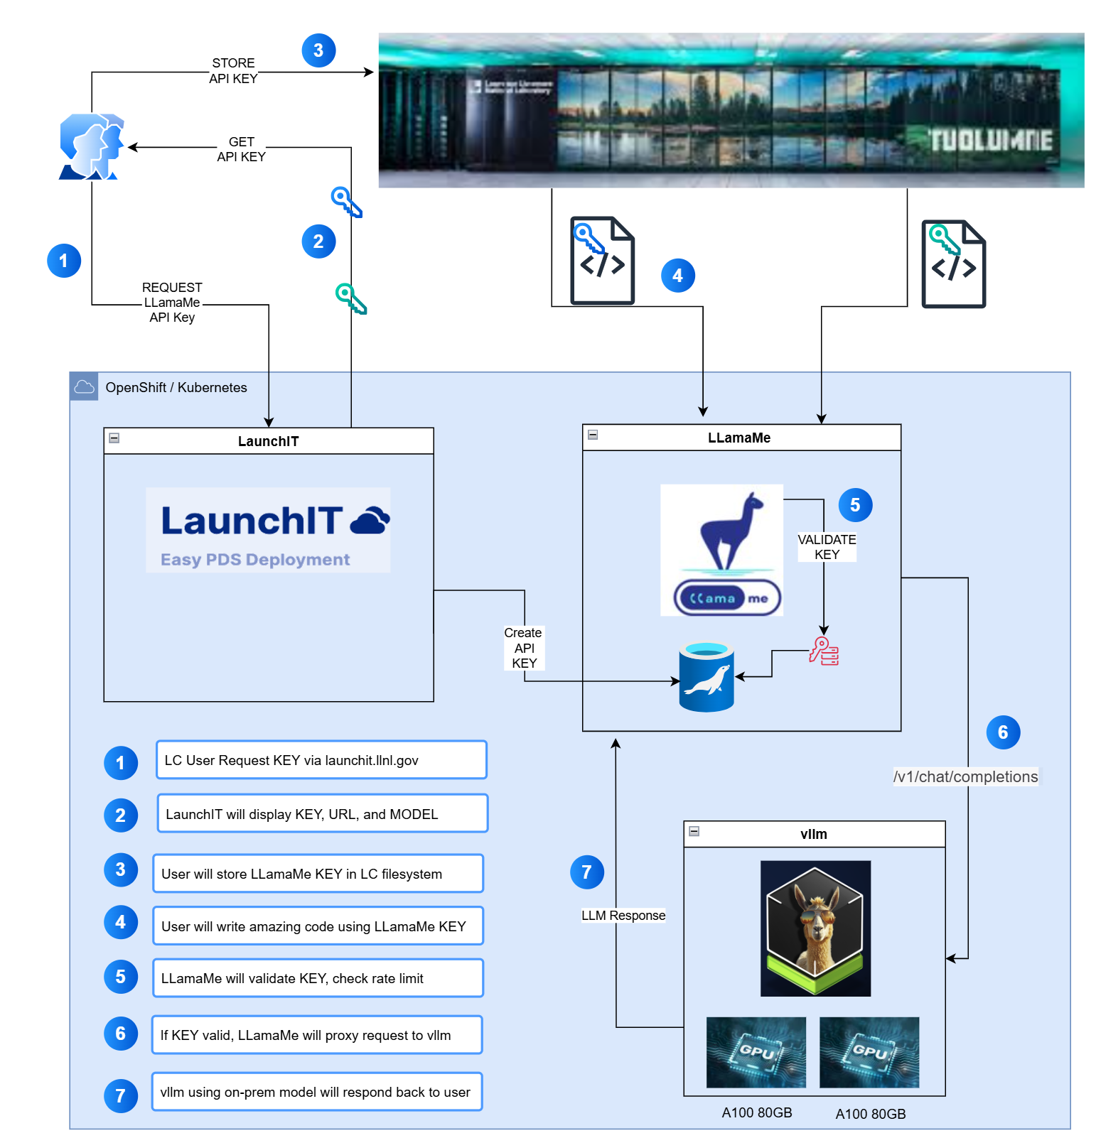
LLamaMe.apps.czapps.llnl.gov
LaunchIT.llnl.gov
WORKFLOW ENABLEMENT GROUP

Slide 8
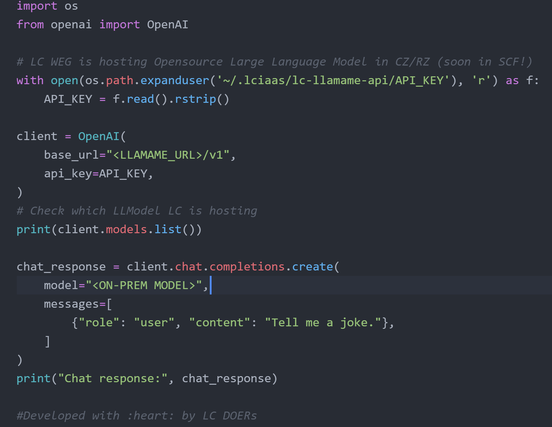
Python
Example
WORKFLOW ENABLEMENT GROUP

Slide 9
Don't have a LLamaMe KEY?
WORKFLOW ENABLEMENT GROUP

Slide 10
Go to LaunchIT to get your Key! (version 2.3)
WORKFLOW ENABLEMENT GROUP
LaunchIT Documentation
CZ / SCF: https://LaunchIT.llnl.gov
RZ: https://rzLaunchIT.llnl.gov

Slide 11
What is next?
WORKFLOW ENABLEMENT GROUP
Update model to use Llama 3.3 70B
Deploy LLamaMe - LaunchIT integration in OpenShift
Enable email notifications when token is about to expire
Can we support more than 1 model?
GPU nodes are expensive $$$
LC SciChat - powered by paperQA Retrieval Augmented Generation (RAG)
Developed by LC DevOps Interns Team (DOIT)
DOERs: Kailey Wong and Arely Rosendes

Slide 12
Stay connected … call me (llámame)
WORKFLOW ENABLEMENT GROUP
Microsoft Team: LC LLamaMe (LLM) | General | Microsoft Teams
Docs: https://hpc.llnl.gov/cloud
Gitlab: LLamaMe Example Repo
Feedback: lit-help@llnl.gov
Bugs: lc-hotline@llnl.gov

