Slide 1
WEAVE Environment & WEAVE Badging Program
Lina Muryanto
WEAVE Team
ASQ – WSC
Presented by Jane Herriman

Slide 2
WEAVE environment
Spack-based Python virtual environment:
WEAVE tools – open source:
Orchestration: Maestro, Merlin
Simulation and data management: Sina, Kosh
Simulation evaluation: Trata, Ibis
Visualization: Pydv
Commonly used Python packages (PyTorch, Matplotlib, Scikit-learn, etc)
Read-only and available to everyone on LC (in CZ, RZ and SCF)

Slide 3
WEAVE environment – what is new?
Based on Spack 0.22.1 – ‘develop’ version on CZ and RZ (toss4, blueos and cray)
’stable’ version on CZ and RZ is still based on Spack 0.20 (toss4 & blueos)
Close-side toss4 and blueos are still running Spack 0.20-based WEAVE (Spack 0.22.1-based WEAVE will be deployed soon on the close side).

Slide 4
WEAVE environment
Users activate the environment by running one of the following commands:
For production/stable version of WEAVE:
On toss4 (no AMD GPU):
source /usr/apps/weave/weave-prod-cpu/bin/activate
On blueos:
source /usr/apps/weave/weave-prod-gpu/bin/activate
For develop version of WEAVE: (toss4 (all) & blueos)
On toss4:
source /usr/apps/weave/weave-develop-cpu/bin/activate
On blueos or cray:
source /usr/apps/weave/weave-develop-gpu/bin/activate

Slide 5
Create a local virtual environment based on WEAVE environment.
Notes:
`-v latest-stable` bases on frozen spack install
`-v latest-develop` may need to recreate when underlying spack install is cleaned up (happens regularly because cache is so huge)

Slide 6
What does create_venv.sh / create_venv.csh do?
Creates a self-contained virtual environment based on WEAVE environment:
Renames ~/.local temporarily
It saves away PYTHONPATH to _OLD_VIRTUAL_PYTHONPATH and unset PYTHONPATH
Creates the virtual environment
Updates PATH, PYTHONPATH, JUPYTERPATH
Restores ~/.local
Pip installing more packages in the activated virtual environment will be installed in the virtual environment – nothing will get installed outside the virtual environment.
Notes:
moves .local to ensure vent is self contained

Slide 7
WEAVE Badging Program – integrate your tools into WEAVE
Expose your tools to the community – may promote community contributions for improvements, bug fixes and new features.
Ensure your tools are compatible with other packages in WEAVE environment.
Make it easier to get your tools to be available on platforms on all zones – where WEAVE is deployed.
Badged tools’ owner(s) keep full control of features support and release cycle. WEAVE team only test and deploy the badged tools.

Slide 8
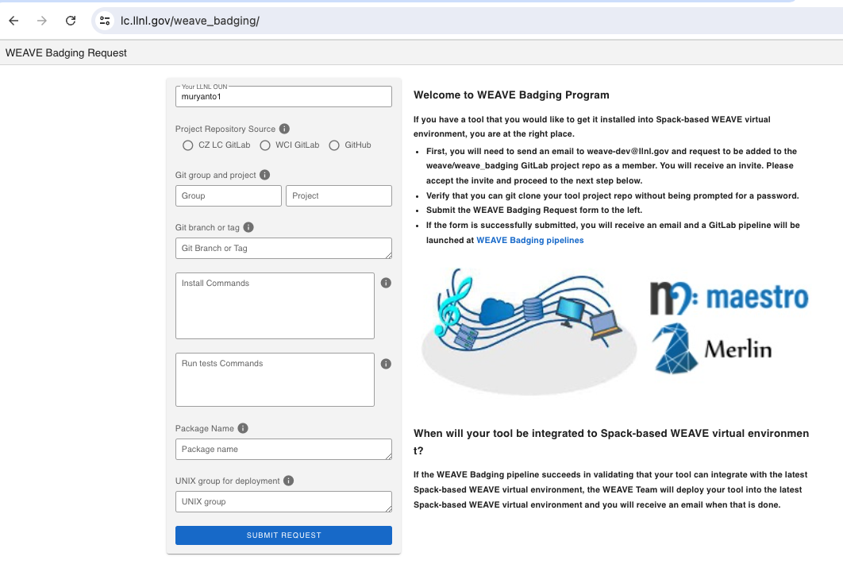
WEAVE Badging Request
Where the tool is? LC GitLab, WCI-GitLab or GitHub.
List of command(s) to install the tool.
https://lc.llnl.gov/weave_badging
List of commands to run tests to validate the tool installation.
Package name as listed in ‘pip list’ output.
UNIX-group for the tool to be deployed under.
Badged tool .json
WEAVE Badging
CZ
More info on the tool:
Link to documentation. Maintainer(s). This info wil be included in WEAVE documentation.
RZ
SCF

Slide 9
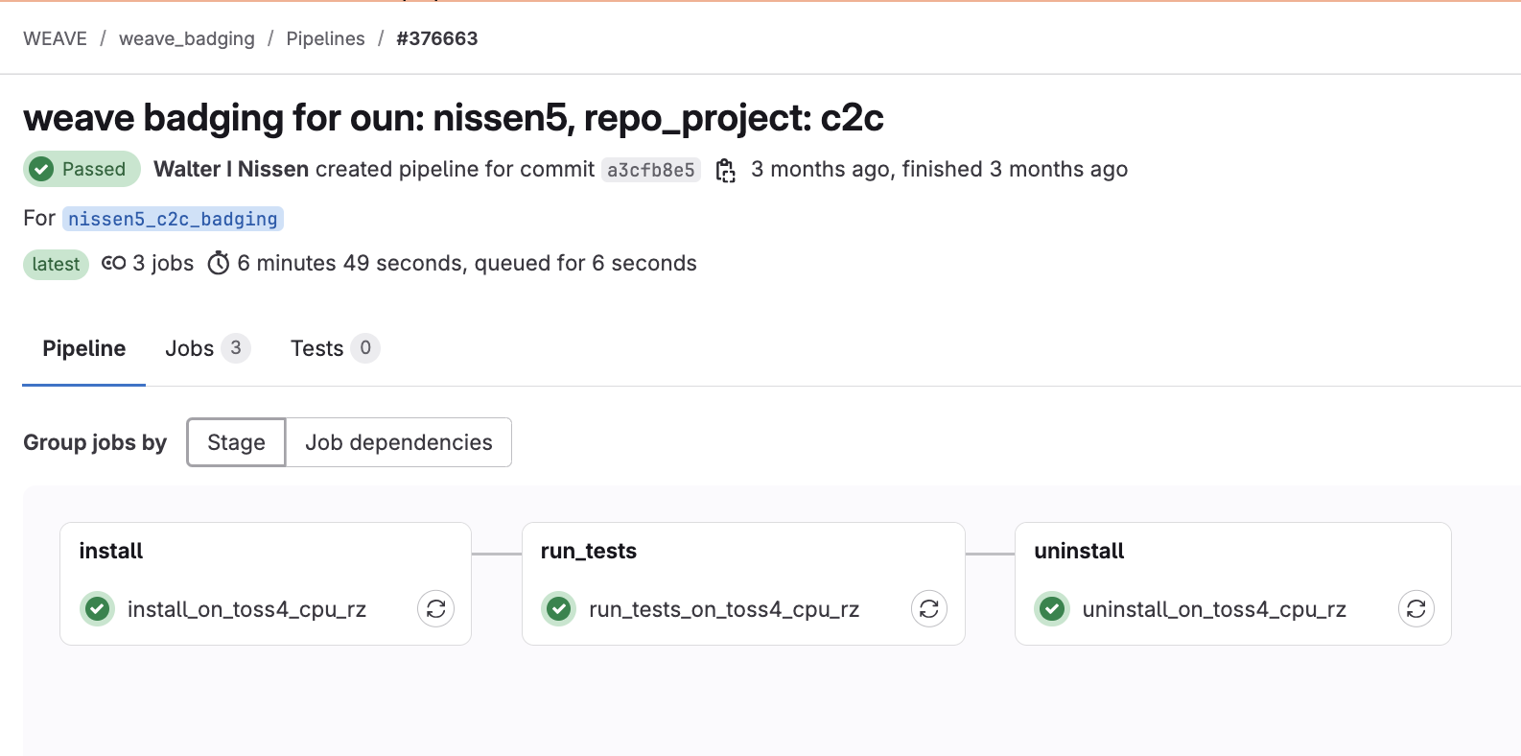
WEAVE Badging Request

Slide 10
WEAVE CI/CD
/usr/apps/weave
CZ
weave/spack_core_environment
weave/weave_ci
Spack install + testing + create view
Create WEAVE venv + install badged tools + testing + deployment
Sync GitLab Repos
/usr/apps/weave
RZ
weave/spack_core_environment
weave/weave_ci
Spack install + testing + create view
Create WEAVE venv + install badged tools + testing + deployment
upload
Nexus
wci-repo
/usr/apps/weave
SCF
weave/spack_core_environment
weave/weave_ci
download
+ git push
Spack install + testing + create view
Create WEAVE venv +install badged tools + testing + deployment

Slide 11
WEAVE CI/CD
/usr/apps/weave
CZ
weave/spack_core_environment
weave/weave_ci
Upload buildcache & repo mirrors
Spack install + testing + create view + create buildcache
Create WEAVE venv + install badged tools + testing + deployment
Sync GitLab Repos
/usr/apps/weave
RZ
weave/spack_core_environment
weave/weave_ci
Nexus
wci-repo
Spack install + testing + create view
Create WEAVE venv + install badged tools + testing + deployment
Download buildcache
/usr/apps/weave
Close side Nexus
wci-repo
SCF
weave/spack_core_environment
weave/weave_ci
Download buildcache & repo mirrors & git push
Spack install + testing + create view
Create WEAVE venv +install badged tools + testing + deployment

Slide 12
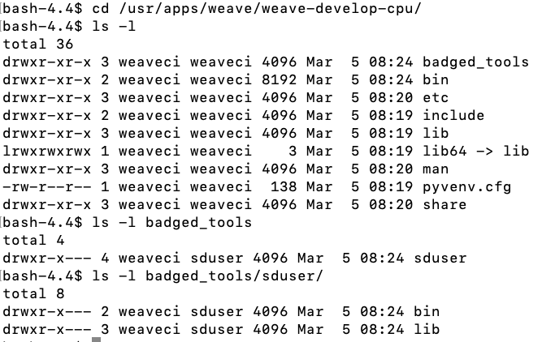
Badged tools with restrictive group permissions
Badged tools that are deployed with restrictive group permissions will be deployed in a separate directory with permission set to be accessible by the specified unix group.

Slide 13
WEAVE CI/CD – weave/spack_core_environment

Slide 14
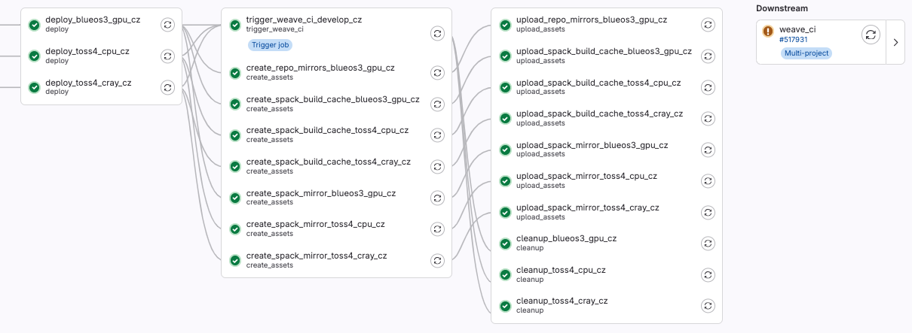
WEAVE CI/CD – weave/spack_core_environment

Slide 15
WEAVE CI/CD – weave/weave_ci

Slide 16
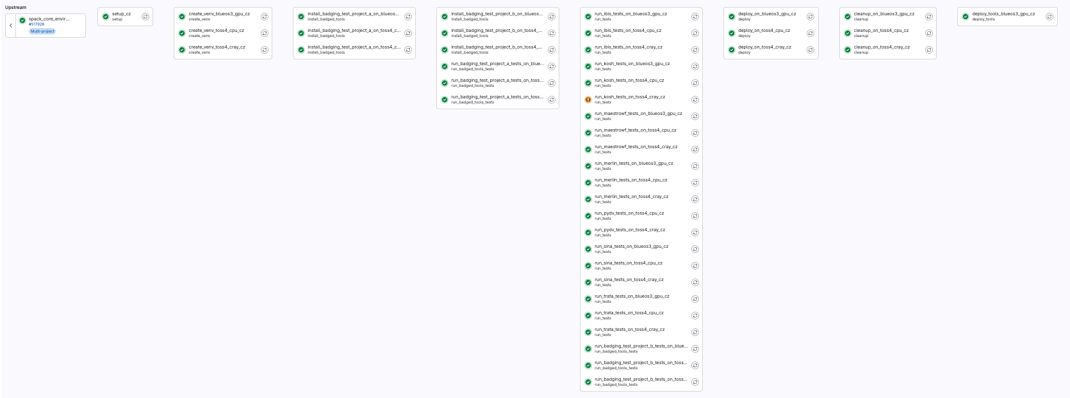
WEAVE CI/CD – weave/weave_ci

Slide 17
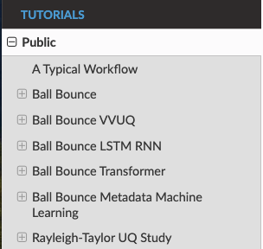
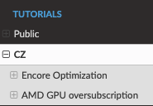
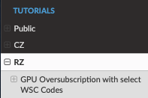
WEAVE Documentations
https://llnl-weave.readthedocs.io/en/latest/
https://lc.llnl.gov/weave
CZ
weave/weave_docs
Docs Build + deploy
https://rzlc.llnl.gov/weave
RZ
weave/weave_docs
Docs Build + deploy
https://lc.llnl.gov/weave
SCF
weave/weave_docs
Docs Build + deploy

Slide 18
Summary
Contact us at:
weave-support@llnl.gov
MS Team WEAVE | General | Microsoft Teams
Documentations:
https://lc.llnl.gov/weave (CZ & SCF)
https://rzlc.llnl.gov/weave (RZ)
WEAVE Badging Request:
https://lc.llnl.gov/weave_badging (CZ & SCF)
https://rzlc.llnl.gov/weave_badging (RZ)

Slide 19
Teamwork - Thanks!
WEAVE Team
Robert Blake, Nicholas Sly and Loic Pottier
Spack team
LC GitLab: Neil J. O’Neil
LC
SD Platform: Kevin Athey, Kevin Gardner
Jeff Long, Stephanie Choate

