Slide 1
El Capitan Systems
LC User Meeting – March 13, 2025
Clay England
Greg Tomaschke
Scott Futral

Slide 2
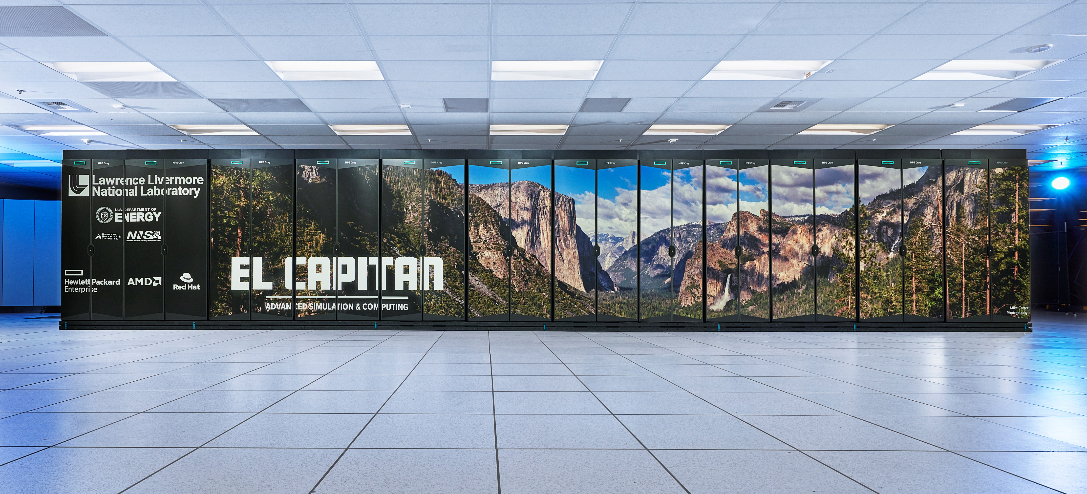
World’s fastest supercomputer

Slide 3
Tuolumne Status
Tuolumne is in "Early Access" mode
Plan to move to "Limited Availability" in the next couple of weeks
In LA mode, banks will be provisioned, but people will be able to continue to use the "guests" bank until Tuo goes into "General Availability" mode. SD customers will be pre-loaded into their bronze banks on Tuo.
Batch Limits:
256 nodes/job, 12 hours max for pbatch
16 nodes/user, 1 hour max for pdebug
Larger/Longer jobs can be accommodated via the LC Hotline.

Slide 4
El Capitan status
Moving to SCF starting March 17
Lustre4 will start clean, no data preserved, plan accordingly
Initial activities:
Validating system function post-move with ‘Friendly Early Users’
Completing Gordon Bell efforts prior to 4/15 deadline
Tri-Lab code porting and validations
Next steps:
Vendor/system development tasks
ATCC-19 user access for exploration (no promises on production cycles!)
ATCC-20 production Sept 2025!

Slide 5
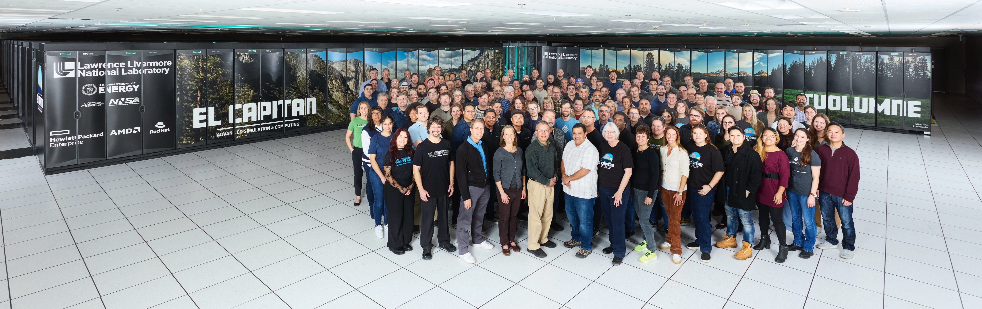
Questions?

